Slide 1
MIPT DIRAC Computing System
Pavelkin Ivan
MIPT
2018

Slide 2
GRID @ MIPT
• CPU: 532 core
– 18 nodes x 2 x 6 cores = 216 cores
– 20 nodes x 2 x 8 cores = 320 cores
• Storage: 1 PB raw
• Network: 10 Gb

Slide 3
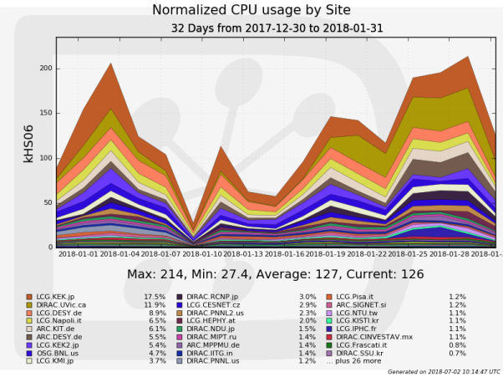
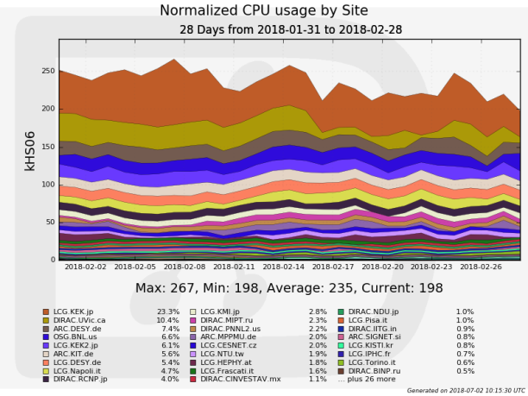
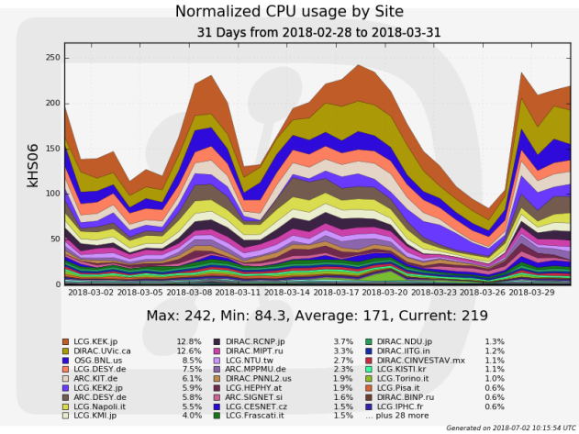
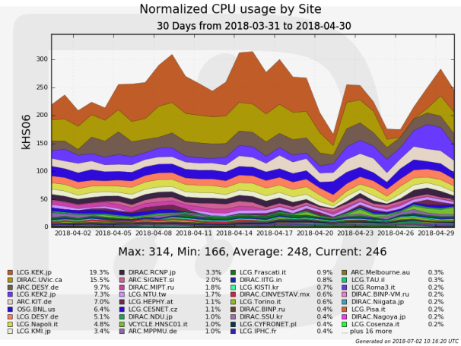
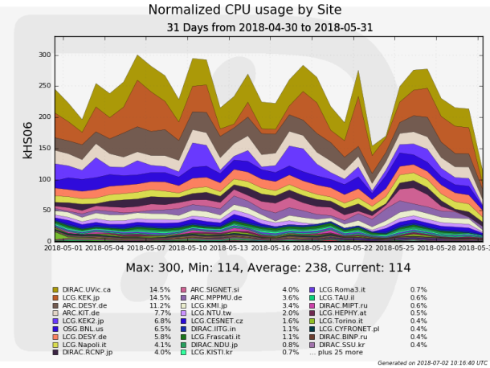
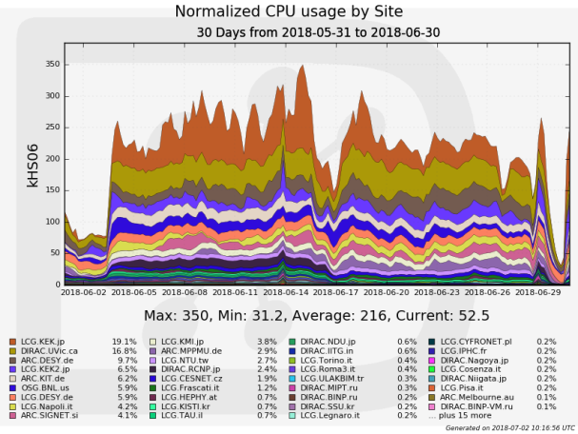

Slide 5
