Slide 1
Status and perspectives of Troitsk nu-mass experiment
(2018)

Slide 2
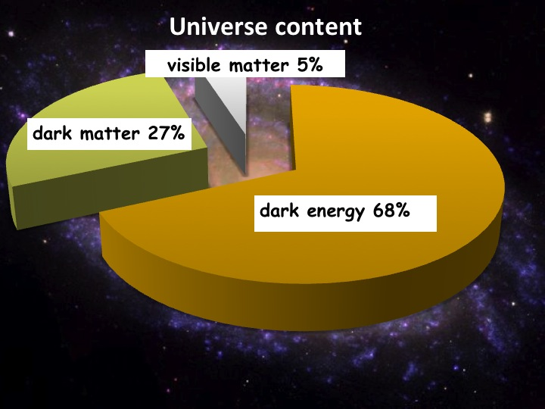
Motivation

Slide 3
So, why keV- neutrino?
Candidate for Warm Dark Matter
LHC results confirm expectations from Standard Model, but
Neutrino mass, Dark Energy and Dark Matter are well beyond SM
There is a set of candidates for DM, like WIMPs, they should be heavy and cold – but it contradicts cosmological structures at small scales
Sterile neutrino with keV-scale mass is a good candidate for Warm Dark Matter.
See - White Paper on keV Sterile Neutrino Dark Matter, arXiv:1602.048
PS. keV mass range is not available in oscillation experiments

Slide 4
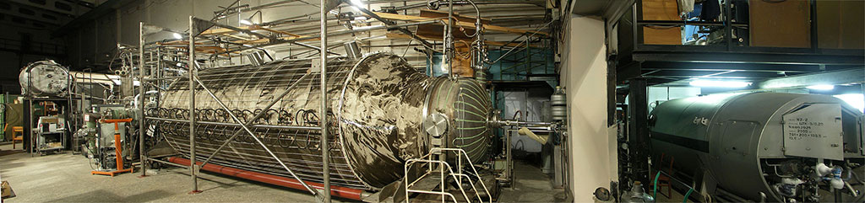
The setup

Slide 5
The idea
Non-zero electron neutrino mass or additional neutrino mass eigenstates changes the shape of (tritium) electron beta-spectrum:
$$T_{2}→HeT^{+}+e^{−}+\overline{ν }$$
The dependency of electron spectrum shape on neutrino mass is the following:
$$S\sim \sqrt{1−\frac{m_{ν}^{2}}{{\left(E_{0}−E\right)}^{2}}}$$
Where $E_{0}$ is beta-spectrum endpoint (without neutrino mass).

Slide 6
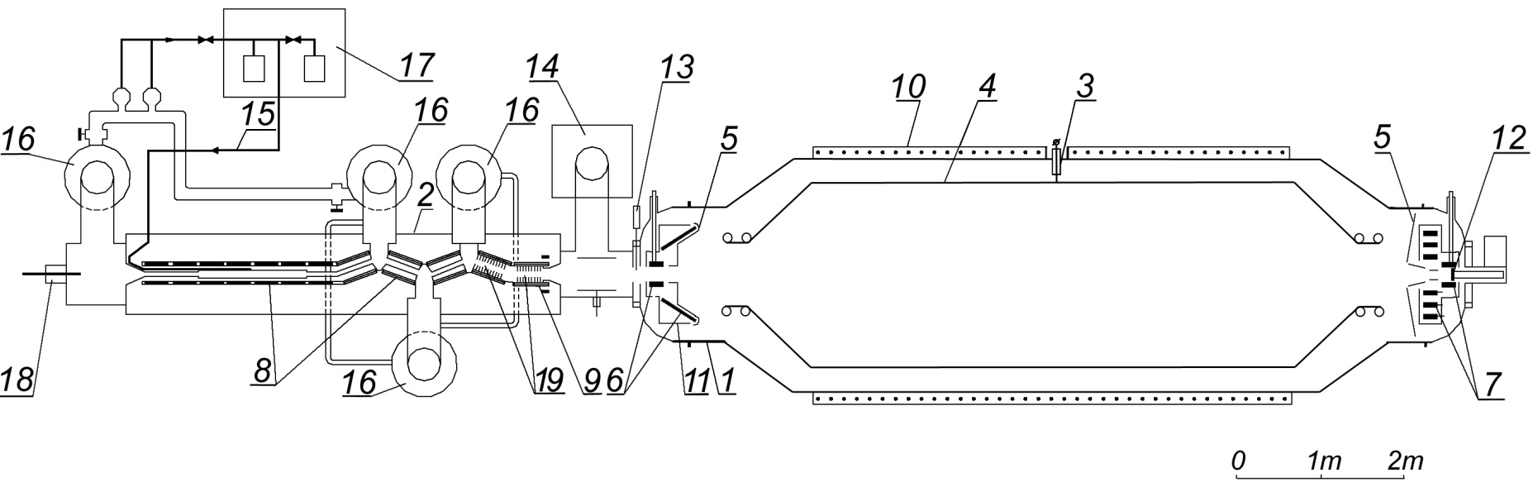
The setup
Circulation system
Pumped tritium is injected back into the system
Spectrometer
Electrons energy analyzed
Ultra-high vacuum
“Tritium tube”
Tritium decays here
Detector
Electrons are registered and counted
Transport system
Electrons transported but tritium pumped out

Slide 7
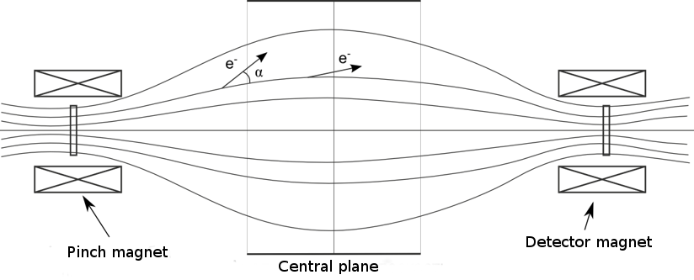
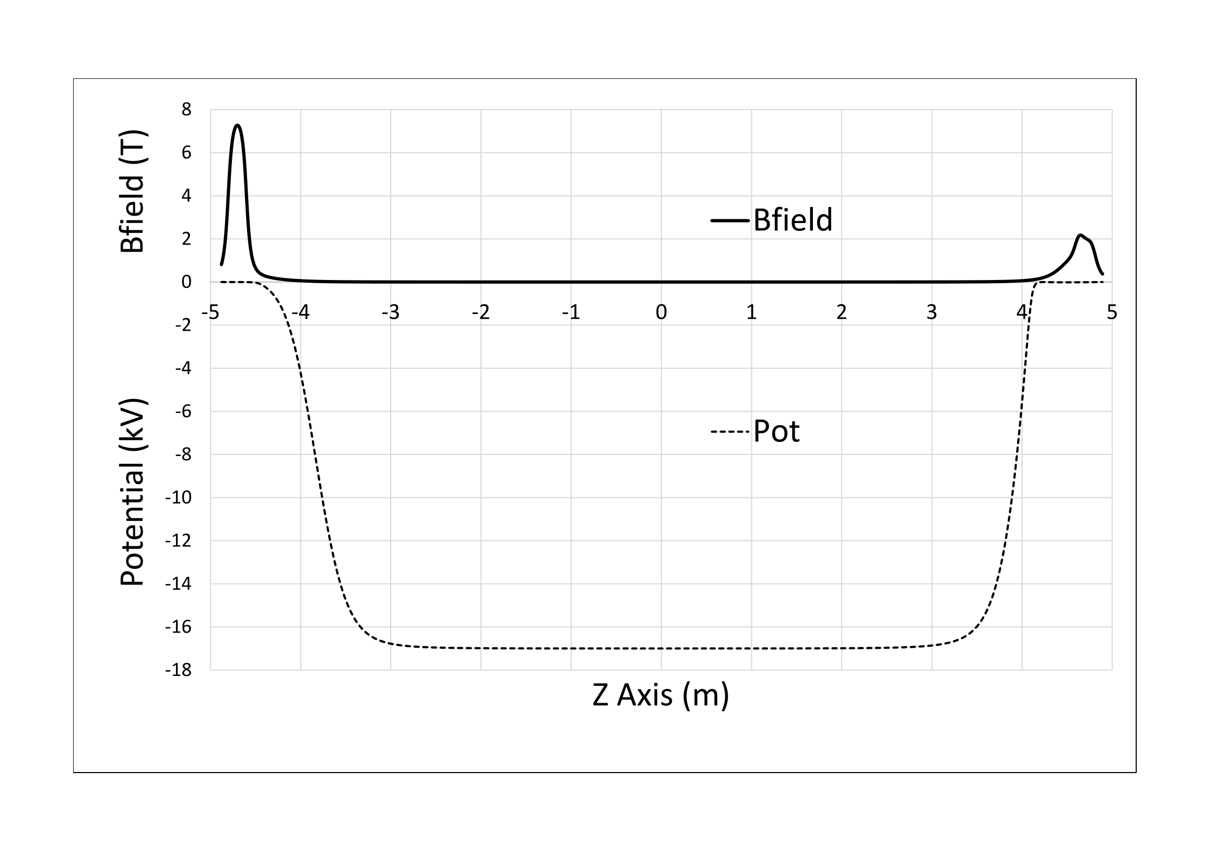
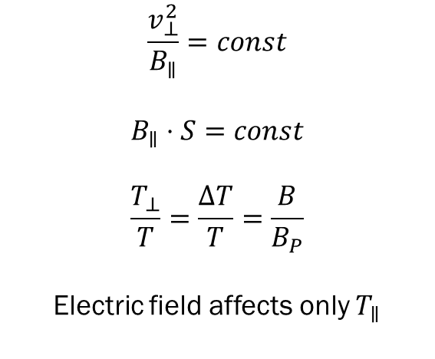
Adiabatic invariant
$$\frac{v_{⊥}^{2}}{B_{∥}}=const$$
$$B_{∥}⋅S=const$$
$$\frac{T_{⊥}}{T}=\frac{ΔT}{T}=\frac{B}{B_{P}}$$
Electric field affects only $T_{∥}$

Slide 8
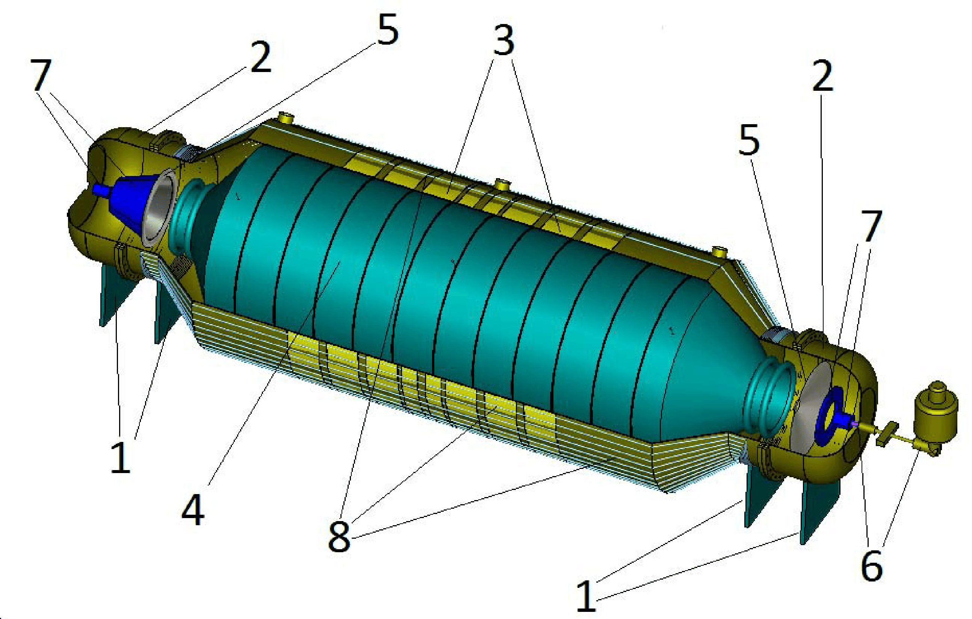
The spectrometer
1- supports,
2 – side cups,
3 – axial winding,
4 – main high voltage electrode,
5 – additional ground electrodes,
6 – detector with liquid N2 Dewar vessel,
7 - superconducting solenoids,
8 – correction coils

Slide 9
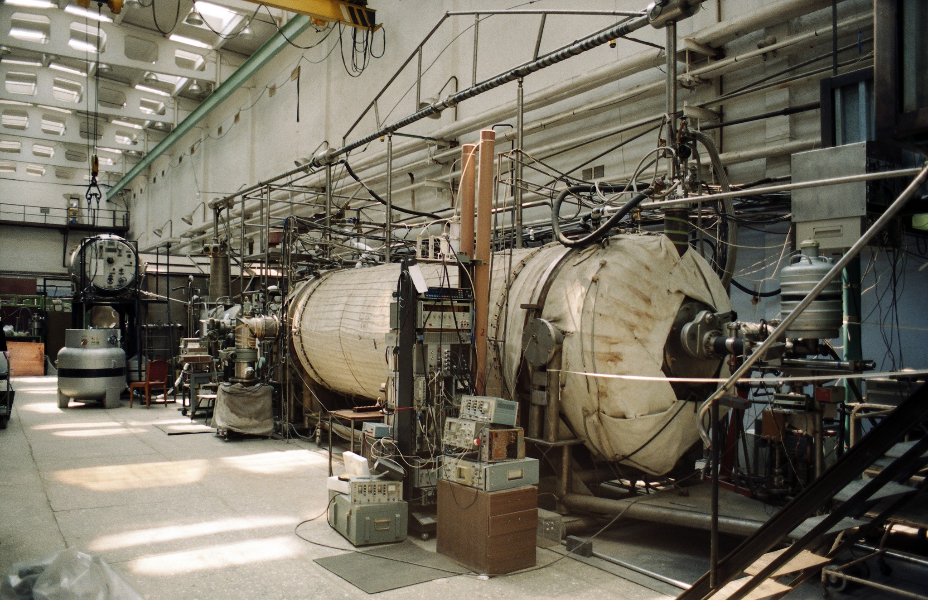
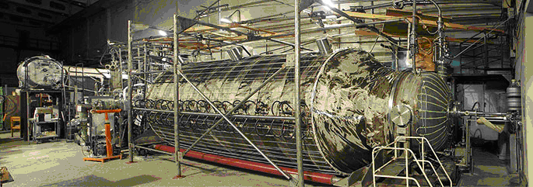
Timeline
Old spectrometer
1985 – start of the experiment
1994 – start of data acquisition
2002 – data acquisition complete
2003-2005 – Krypton measurements
2005-2010 – spectrometer upgrade
2011 – publication of final results for electron neutrino (arXiv:1108.5034)
2012 – start of sterile neutrino program
2015 – first measurements on sterile neutrino program (arXiv:1504.00544)
2018 – first full-scale measurement with TRISTAN detector prototype
New spectrometer

Slide 10
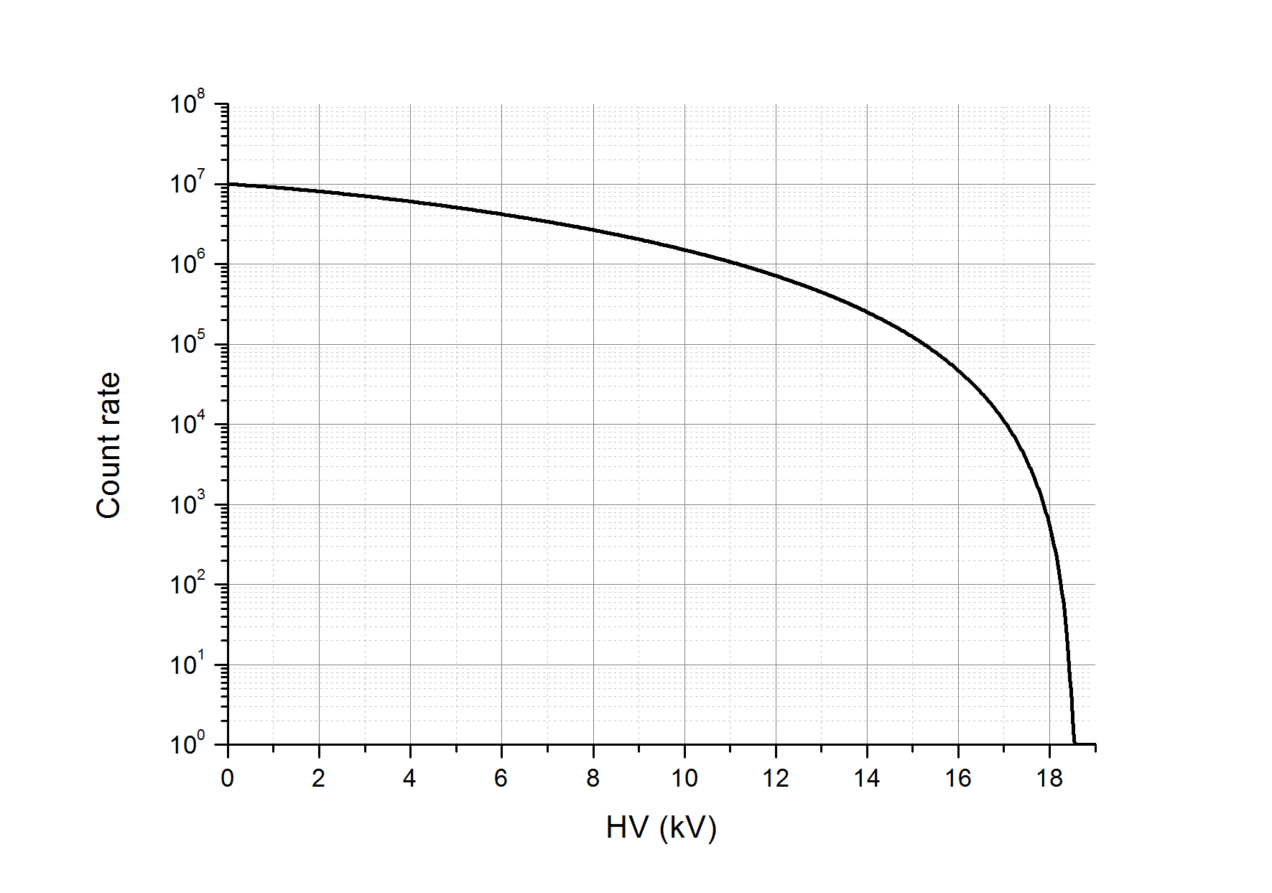
The spectrum

Slide 11
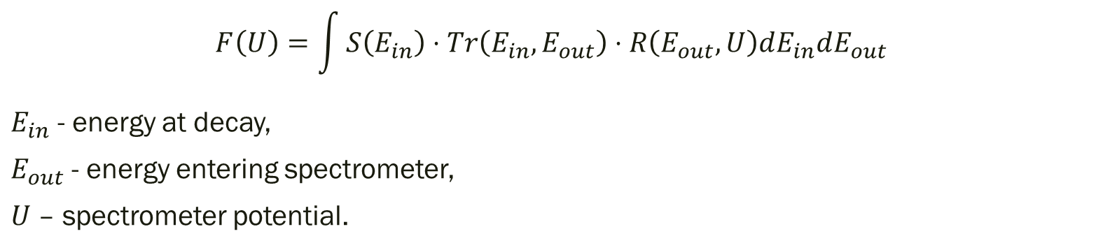
Spectrum shape
Tritium source transmission
Spectrometer resolution
Beta spectrum
$$F\left(U\right)=\int{S\left(E_{in}\right)⋅Tr\left(E_{in},E_{out}\right)⋅R\left(E_{out},U\right)dE_{in}dE_{out}}$$
$E_{in}$ - energy at decay,
$E_{out}$ - energy entering spectrometer,
$U$ – spectrometer potential.

Slide 12
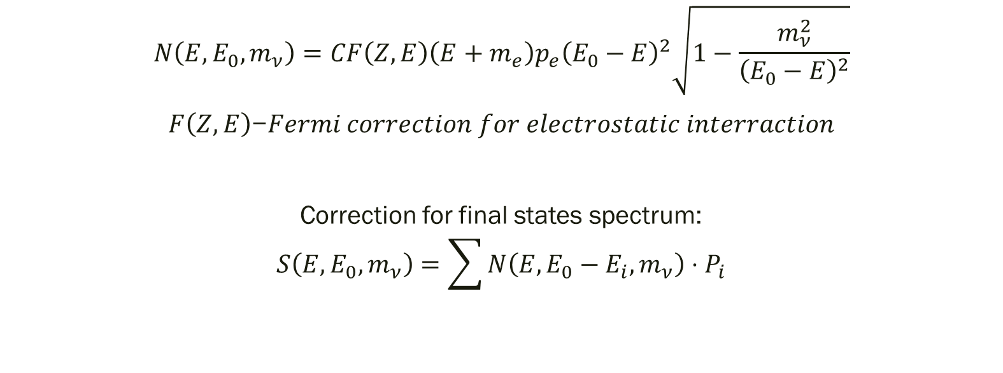
Spectrum shape: beta spectrum
$$N\left(E,{E_{0},m}_{ν}\right)=CF\left(Z,E\right)\left(E+m_{e}\right)p_{e}{\left(E_{0}−E\right)}^{2}\sqrt{1−\frac{m_{ν}^{2}}{{\left(E_{0}−E\right)}^{2}}}$$
$F\left(Z,E\right)$−𝐹𝑒𝑟𝑚𝑖 𝑐𝑜𝑟𝑟𝑒𝑐𝑡𝑖𝑜𝑛 𝑓𝑜𝑟 𝑒𝑙𝑒𝑐𝑡𝑟𝑜𝑠𝑡𝑎𝑡𝑖𝑐 𝑖𝑛𝑡𝑒𝑟𝑟𝑎𝑐𝑡𝑖𝑜𝑛
Correction for final states spectrum:
$$S\left(E,{E_{0},m}_{ν}\right)=\sum{N\left(E,E_{0}−E_{i},m_{ν}\right)⋅P_{i}}$$

Slide 13
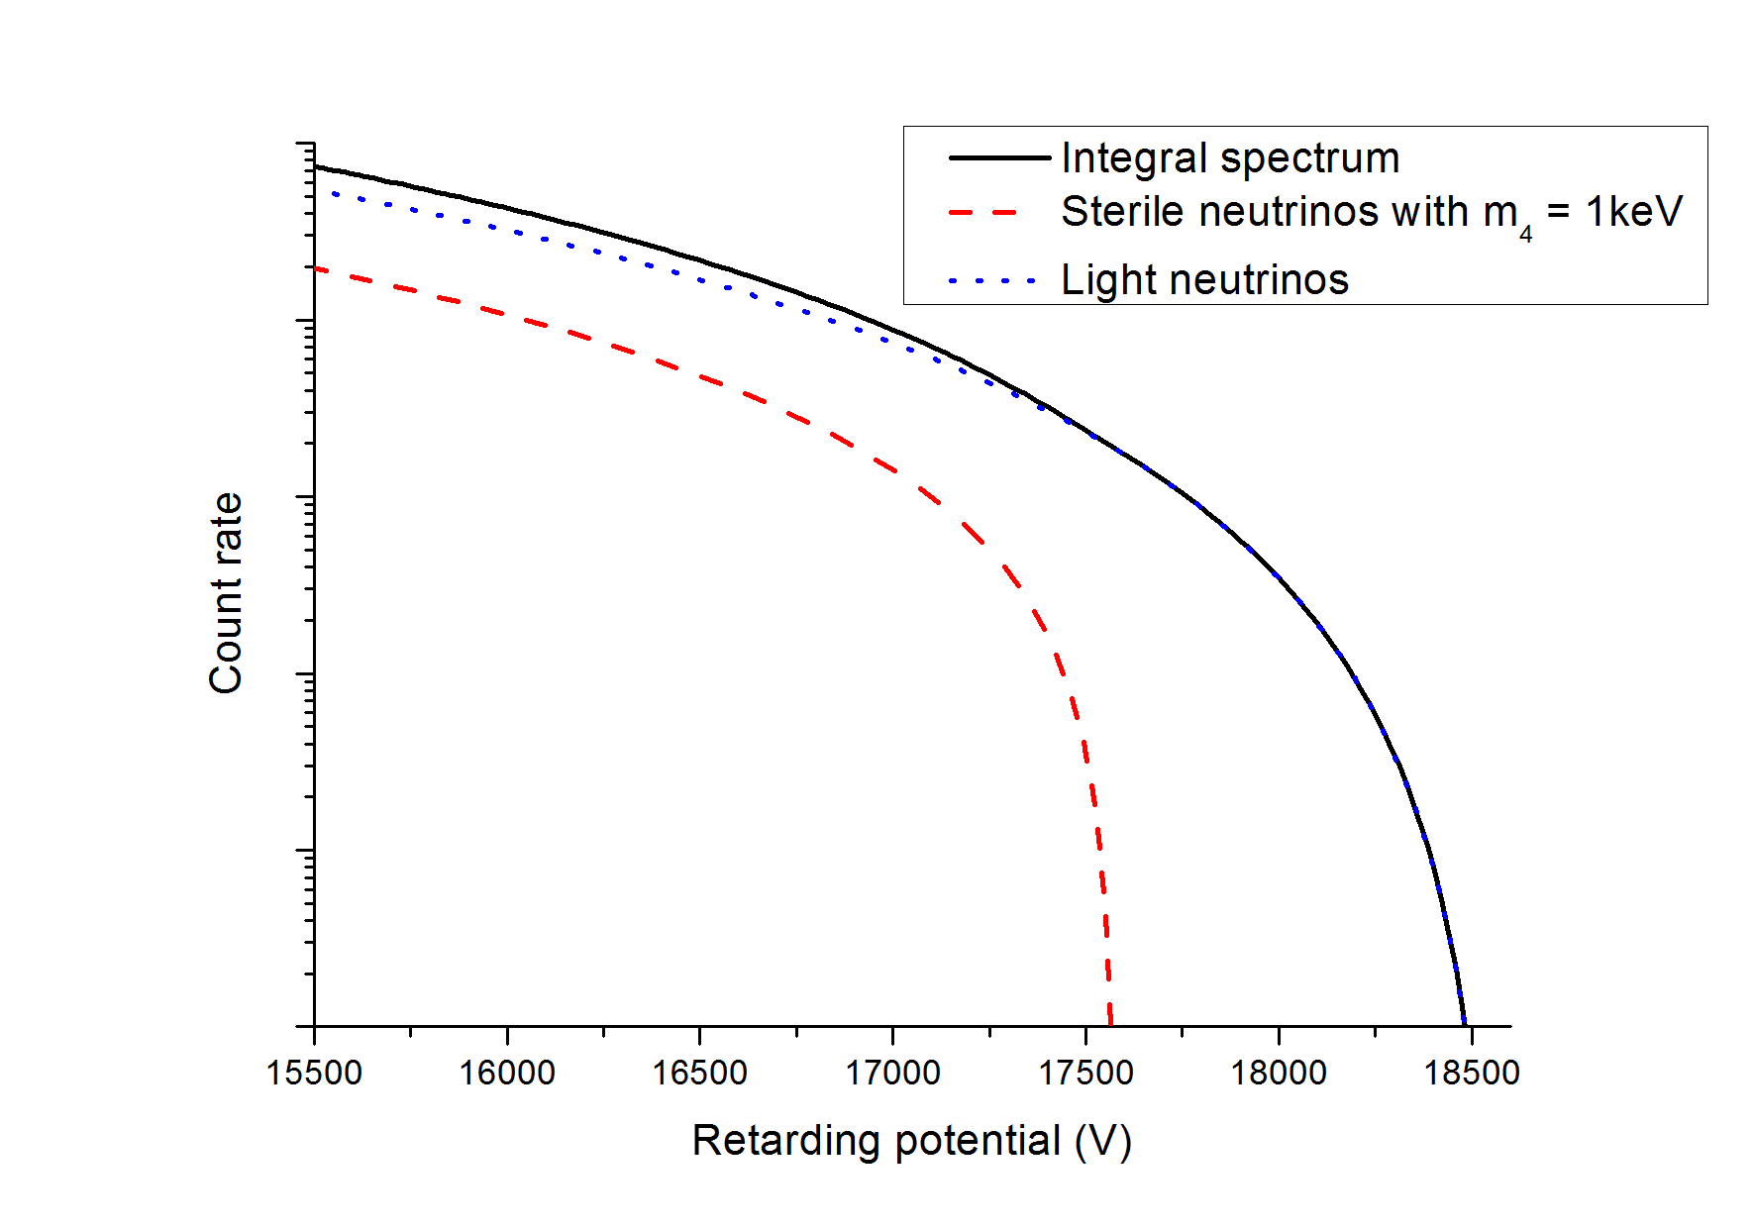
A search for sterile neutrino
$$|ν_{α}> = \sum{U_{αi} |ν_{i}>}$$
$$S\left(E\right)=U_{ex}^{2}S\left(E,m_{x}\right)+\left(1−U_{ex}^{2}\right)S(E,0)$$
One can add additional neutrino components in mixture.
Tritium beta decay could provide information about mass region up to 10 keV
(warm dark matter?).
Spectrum changes like:
Active component
Sterile component

Slide 14
Spectrum shape: transmission
$$Tr\left(E_{in},E_{out}\right)=P_{0}⋅δ\left(E_{in}−E_{out}\right)+\sum{P_{i}L_{i}\left(E_{in},E_{out}\right)}+trap(E_{in},E_{out})$$
Passage without losses
(includes quasi-elastic)
Inelastic losses
(i – number of collisions)
Trapping effect or rear wall backscattering
$$P_{0}=\frac{1}{X}\left(1−e^{−X}\right), P_{1}=\frac{1}{X}\left(1−e^{−X}\right)−e^{−X}, P_{2}=\frac{1}{2X}\left(2−e^{−X}\left(X^{2}+2X+2\right)\right), P_{3}=…$$

Slide 15
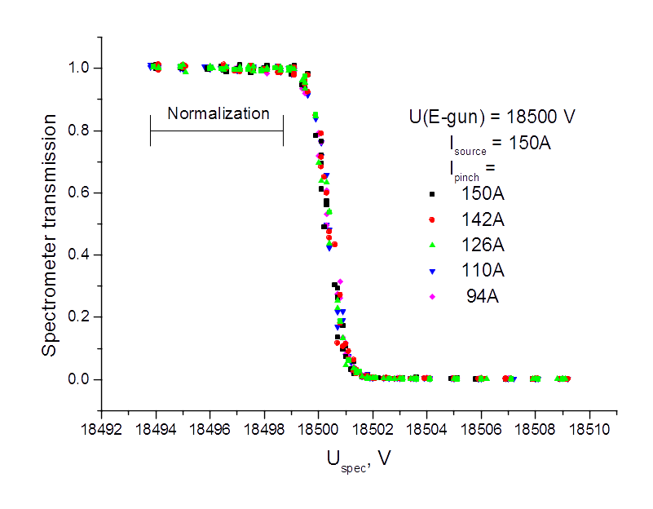
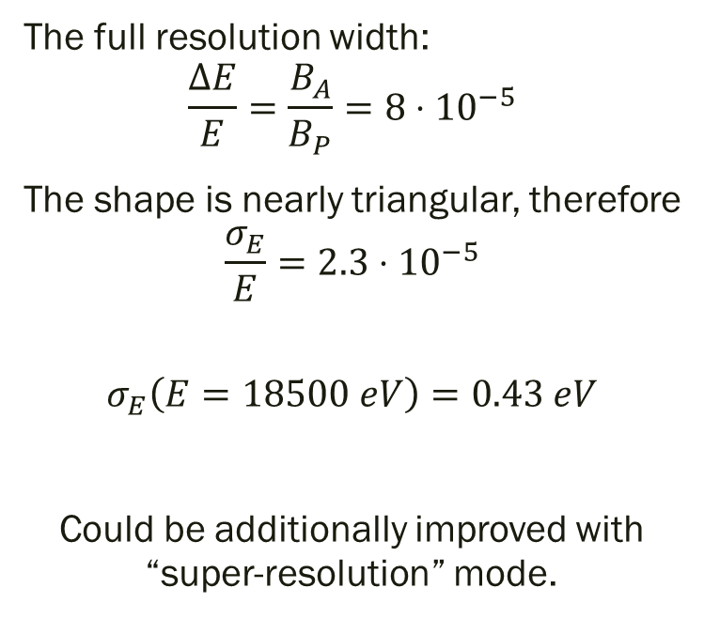
Spectrum shape: resolution
The full resolution width:
$$\frac{ΔE}{E}=\frac{B_{A}}{B_{P}}=8⋅{10}^{−5}$$
The shape is nearly triangular, therefore
$$\frac{σ_{E}}{E}=2.3⋅{10}^{−5}$$
$$σ_{E}\left(E=18500 eV\right)=0.43 eV$$
Could be additionally improved with “super-resolution” mode.

Slide 16
Systematics

Slide 17
Systematics
Trapping effect / Rear wall backscattering
Dead time / pileup
Detector efficiency / events under threshold
Adiabaticity violation / detector backscattering
Source thickness
Spectrometer voltage instability
Final states distribution
See details in https://arxiv.org/abs/1504.00544
Very important!
Not very important at the moment
for now

Slide 18
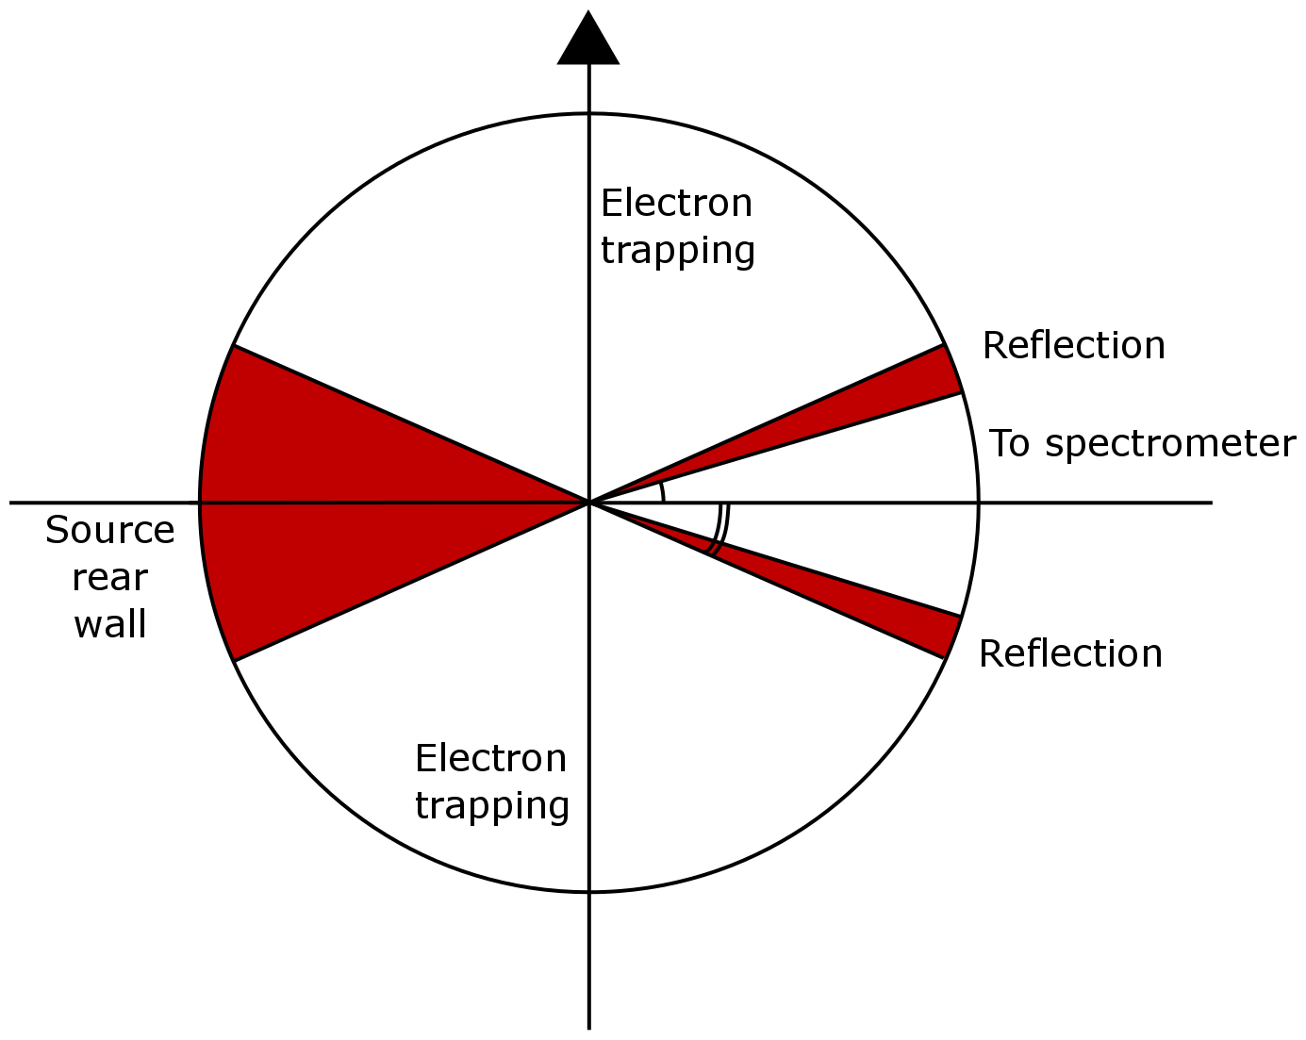
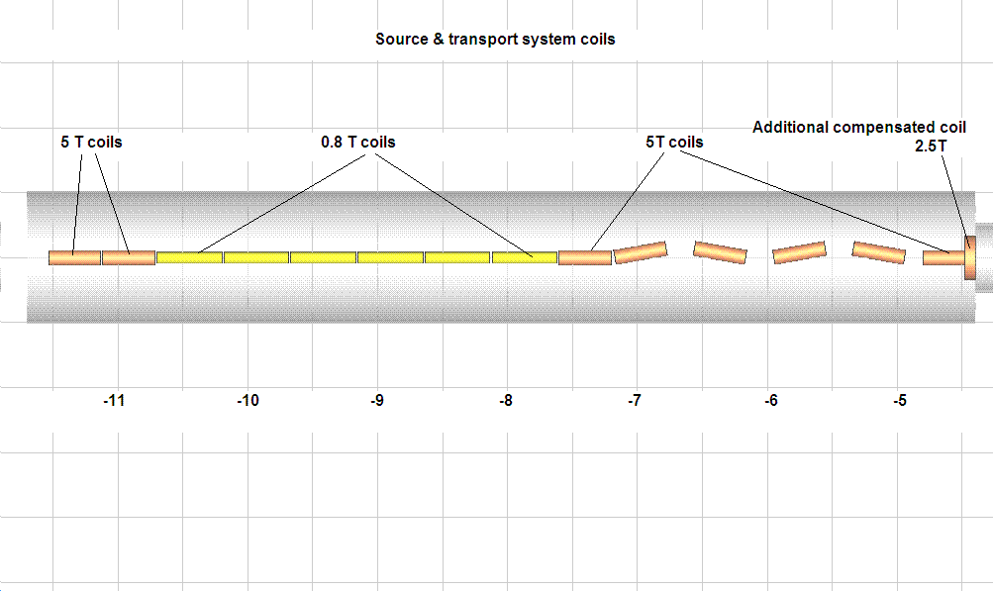
Trapping: basics
Field configuration in tritium source forms a bottle – magnetic Trap
Т₂
Trapped electrons can run back and forth up to thousand times passing few kilometers

Slide 19
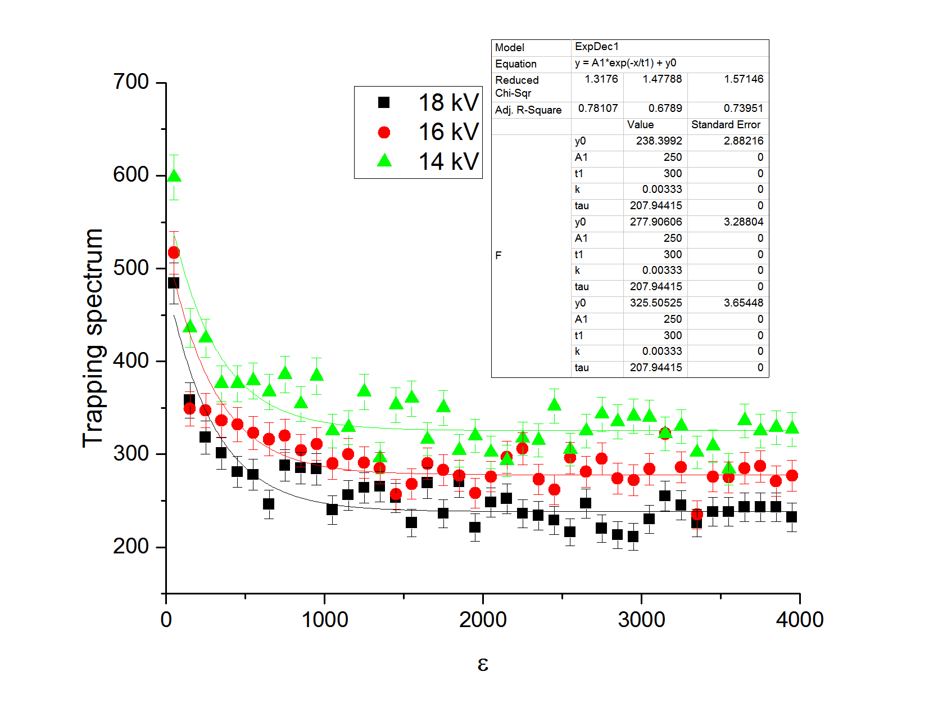
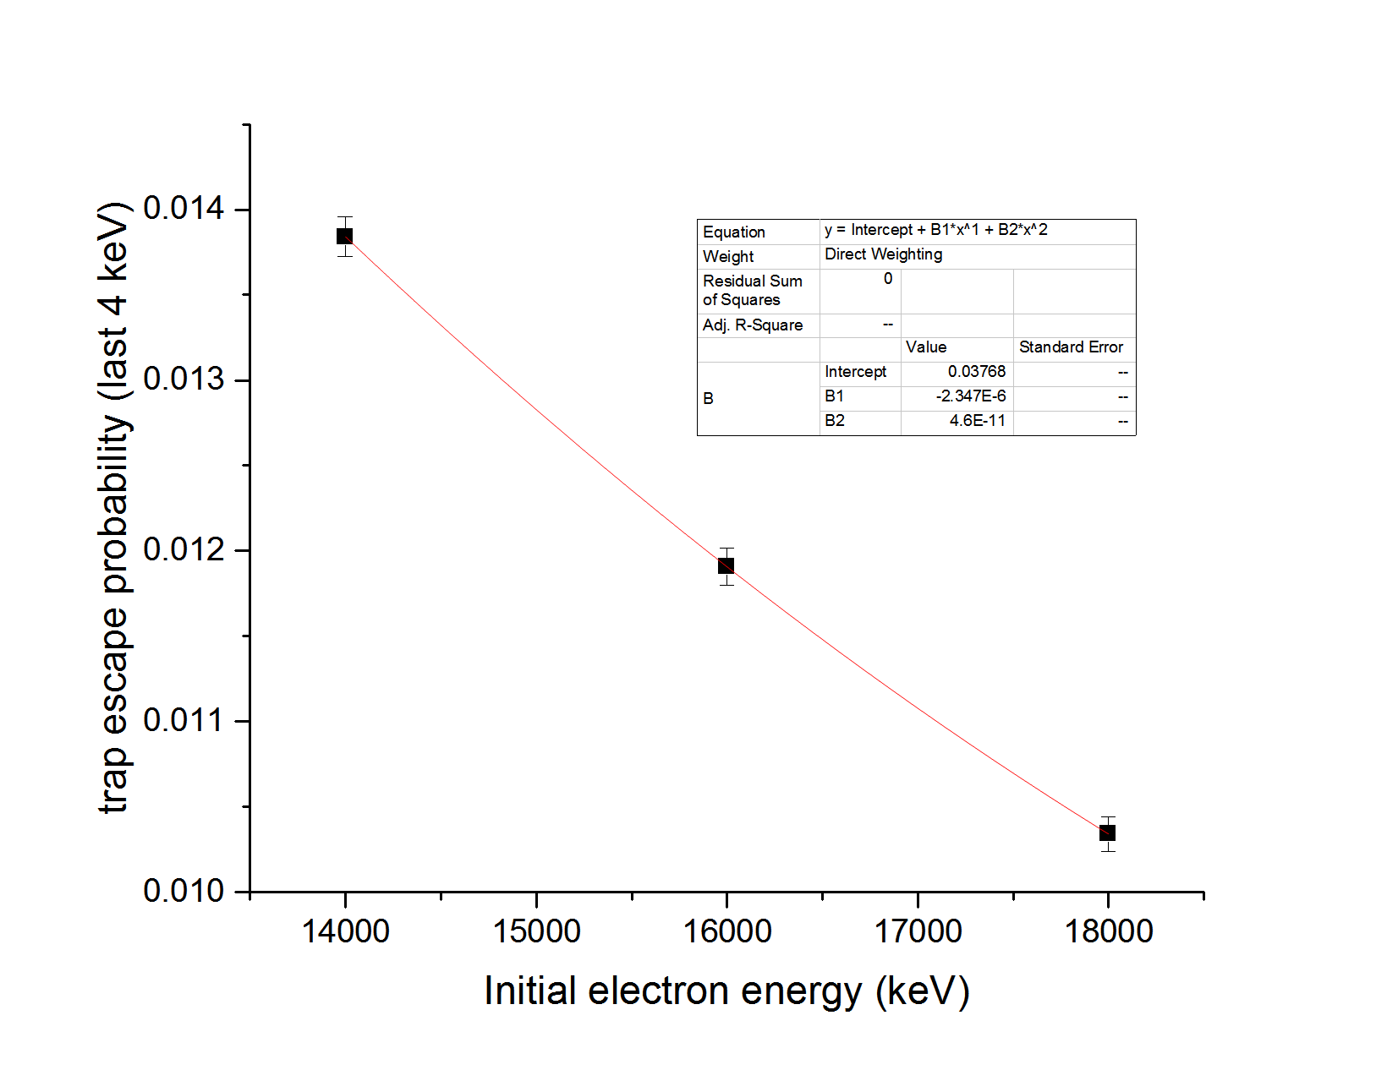
Trapped electrons distort the actual β-spectrum
Simulation
Energy dependence

Slide 20
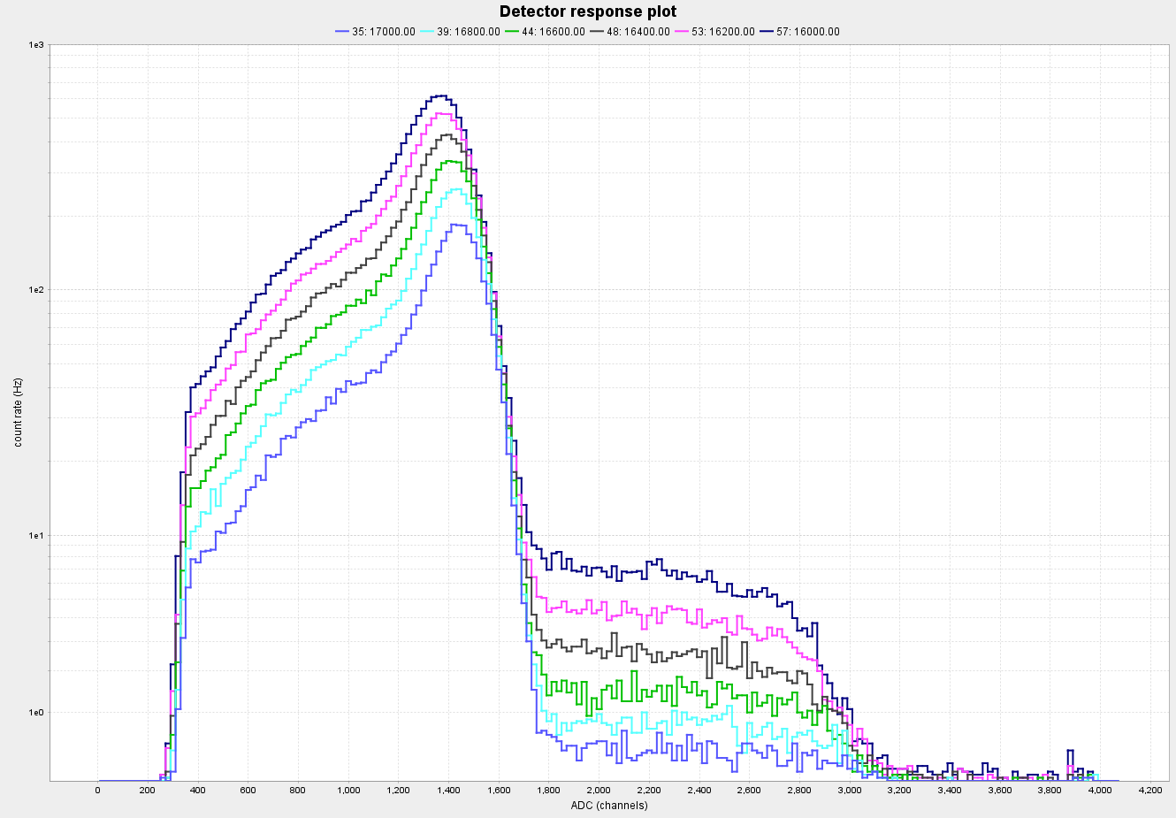
Amplitude spectrum
Detection threshold
Pileup
Signal amplitudes in Si(Li) detector at different spectrometer potentials – different intensity

Slide 21
Results and perspectives

Slide 22
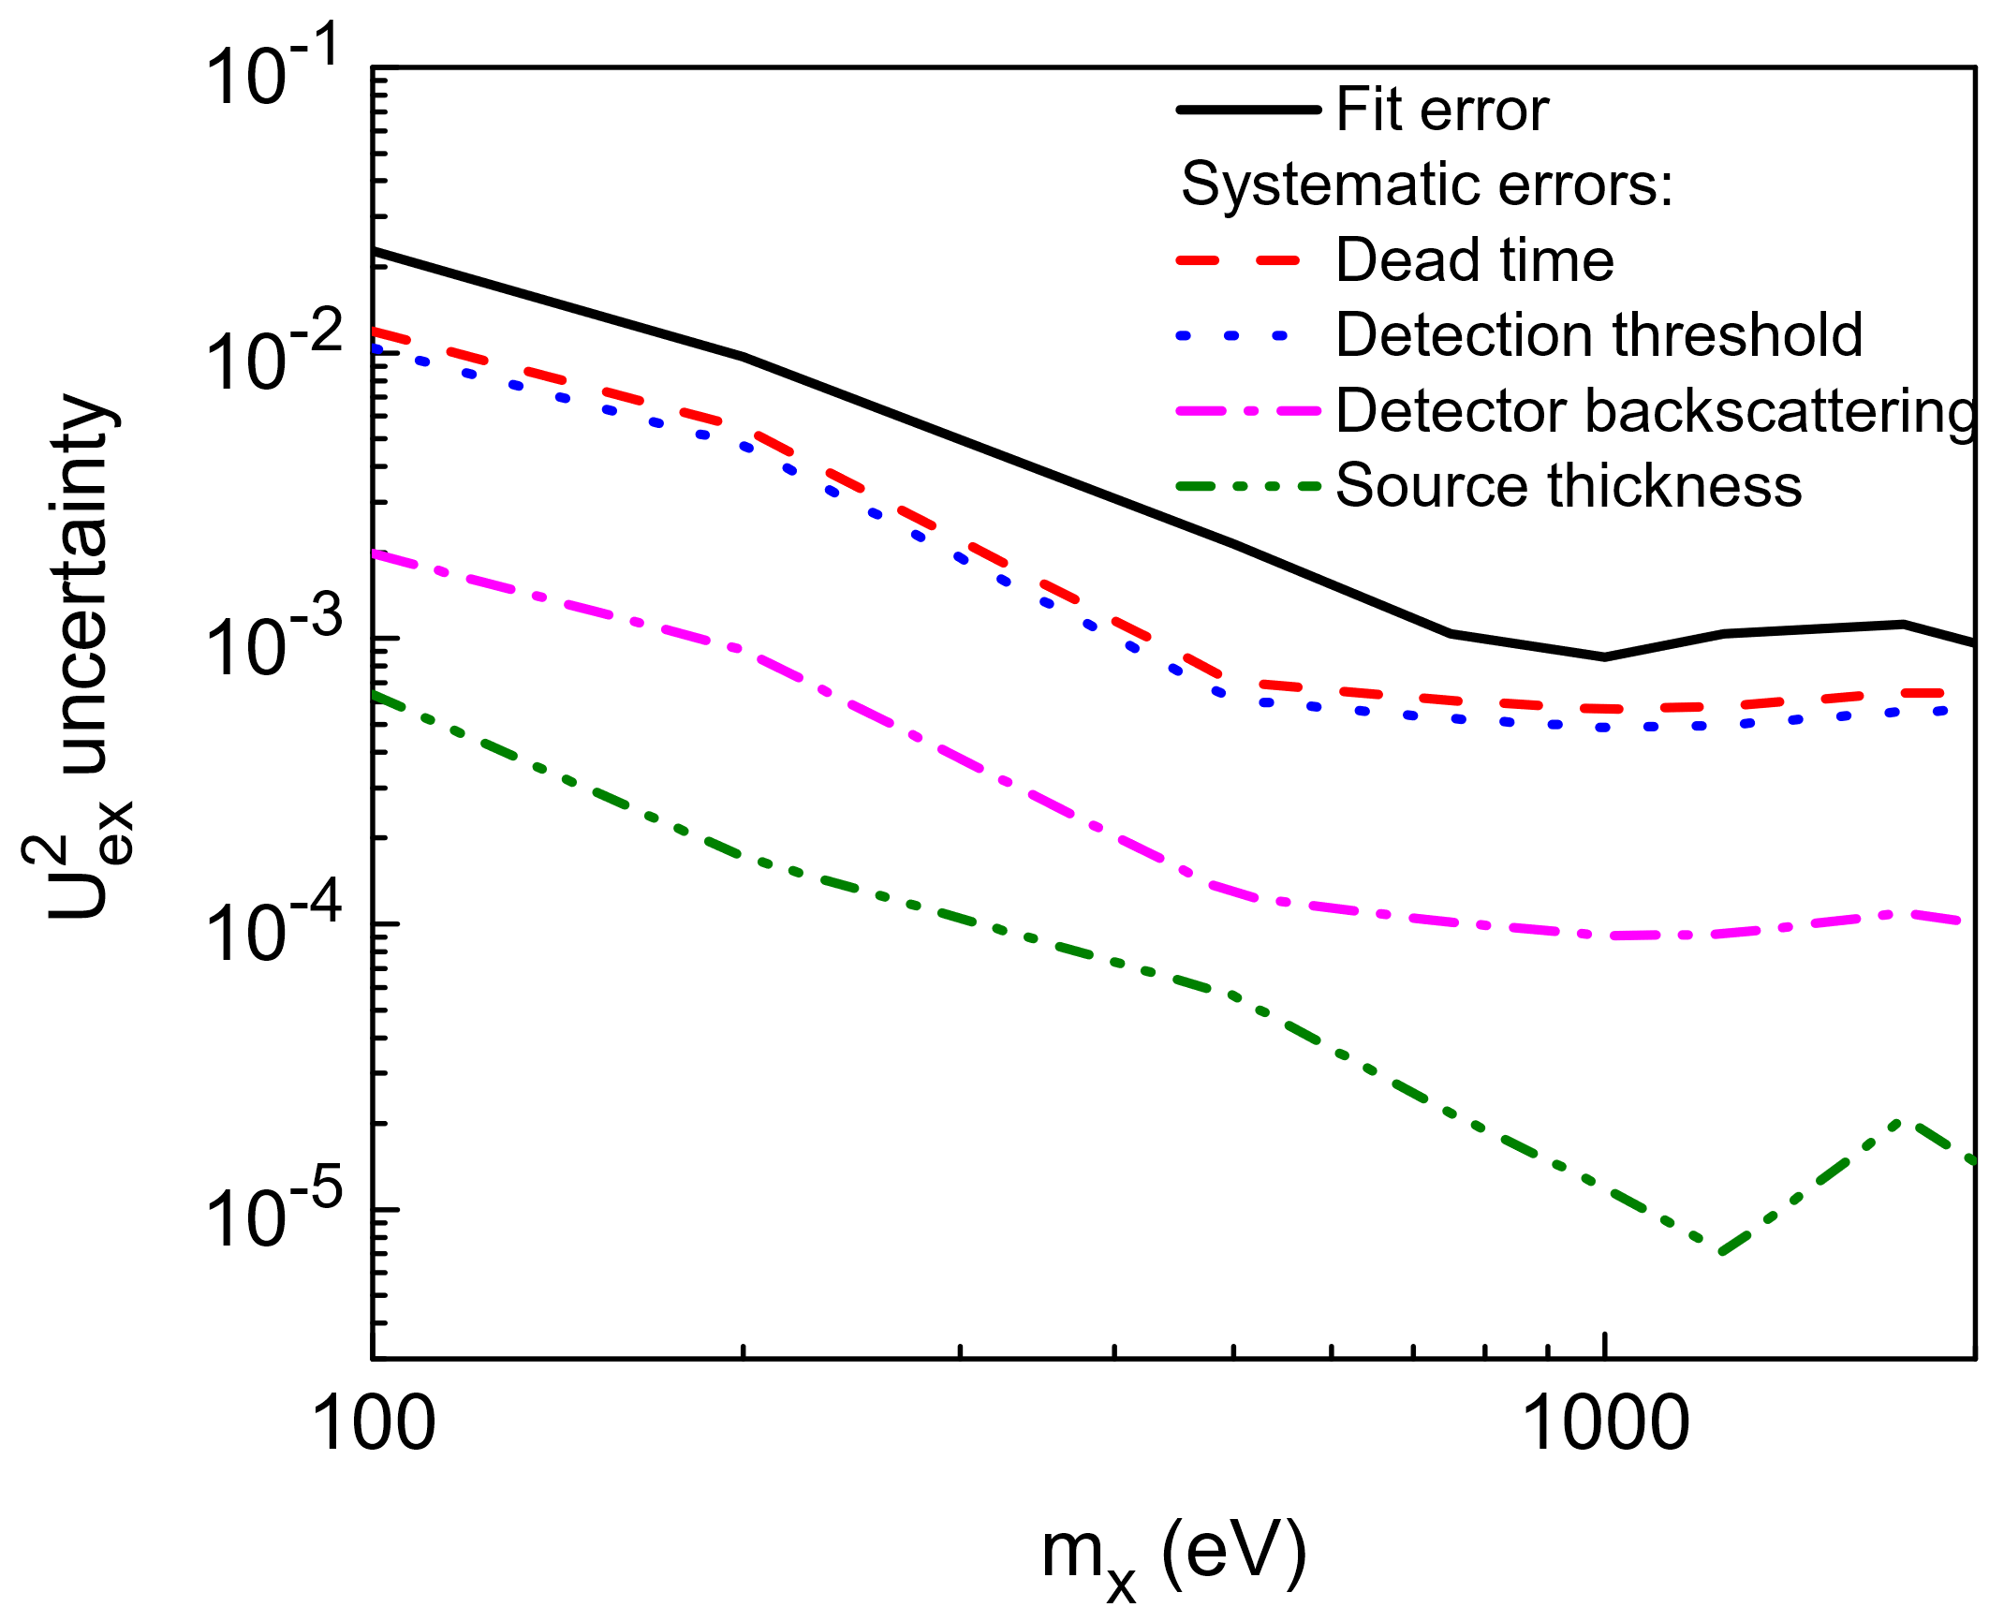
Current results
One experiment ran with enhanced intensity
Systematic errors:
DAQ dead time and pileup
Events under detection threshold
Backscattering from detector (arXiv:1603.04243)
Interaction in the source.
JETP Lett. 105 (2017) no.12, 753-757
DOI: 10.1134/S0021364017120013

Slide 23
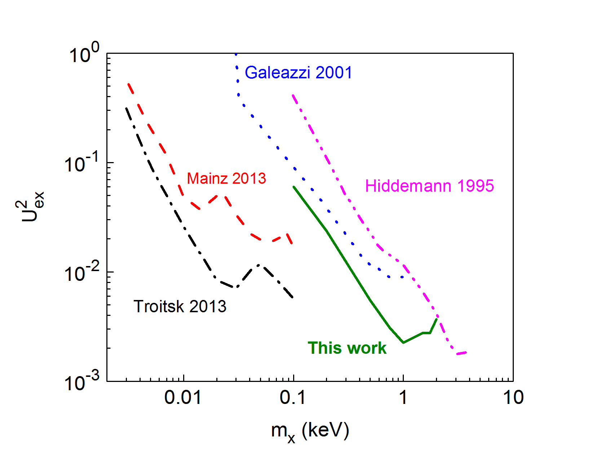
Current results
JETP Lett. 105 (2017) no.12, 753-757
DOI: 10.1134/S0021364017120013
95 % Confidence Level (sensitivity limit) on mixing matrix element

Slide 24
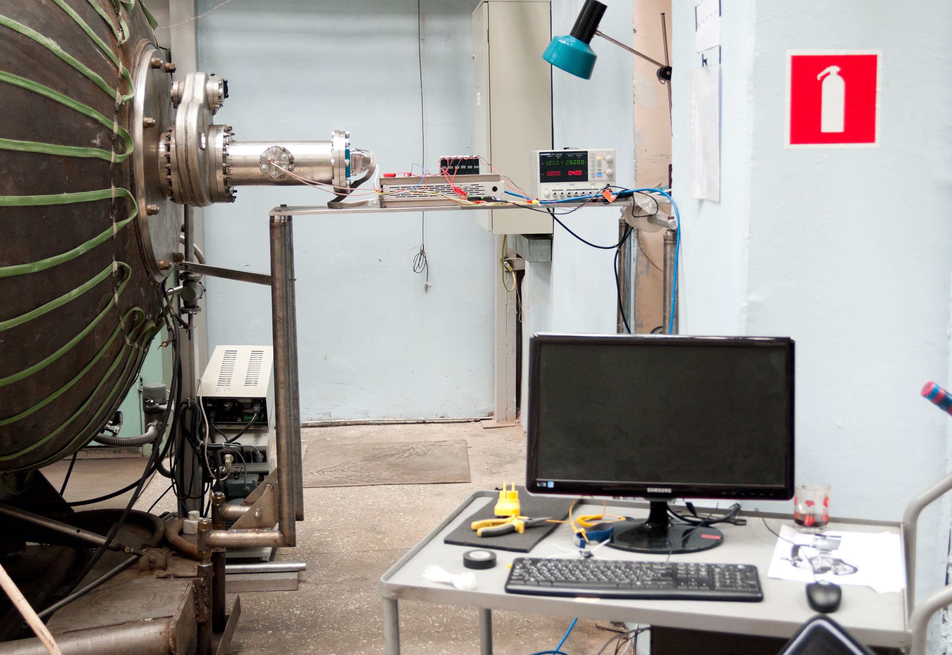
Joint effort with TRISTAN project
Troitsk nu-mass spectrometer
TRISTAN detector prototype
Since 2017 Troitsk nu-mass joined effort with TRISTAN project at MPI Munich.

Slide 25
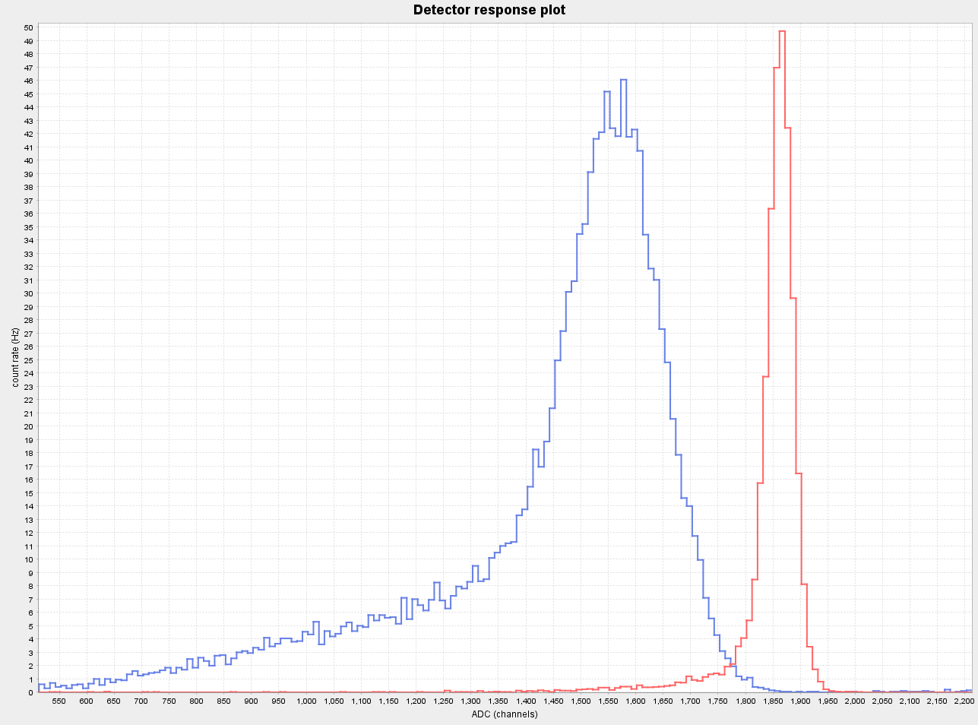
Improvement with silicon drift detector
Multi-pixel detector. Allows higher count rate.
Better resolution and amplitude spectrum shape
Controlled back-scattering conditions.
Modern read-out and on-site preprocessing.

Slide 26
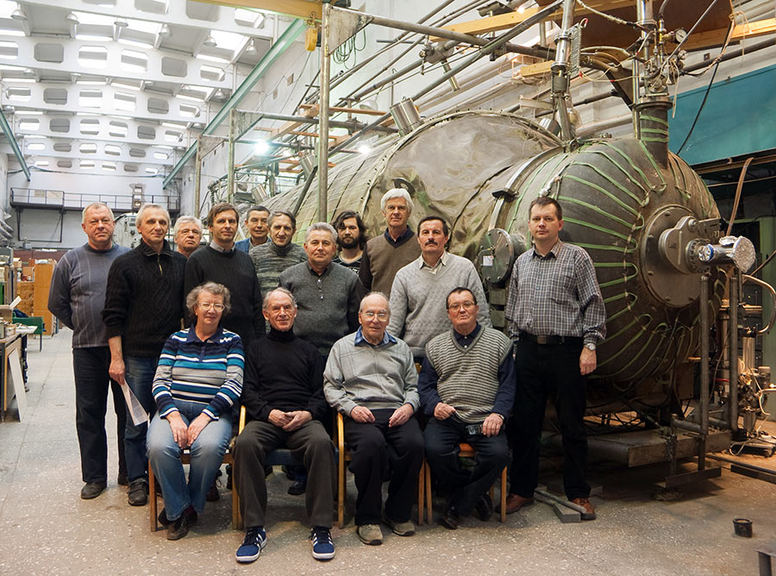
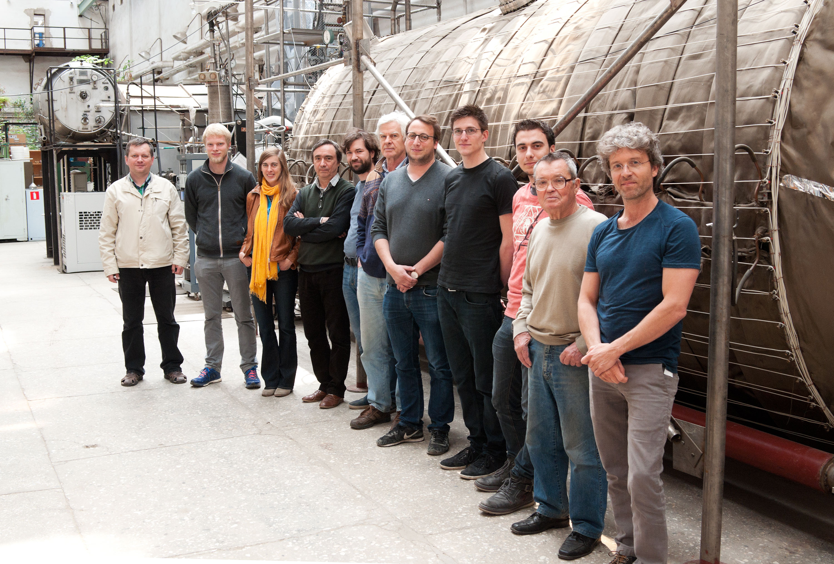
Thank you for your attention
Trotisk nu-mass
TRISTAN in Troitsk

Slide 27
The future

Slide 28
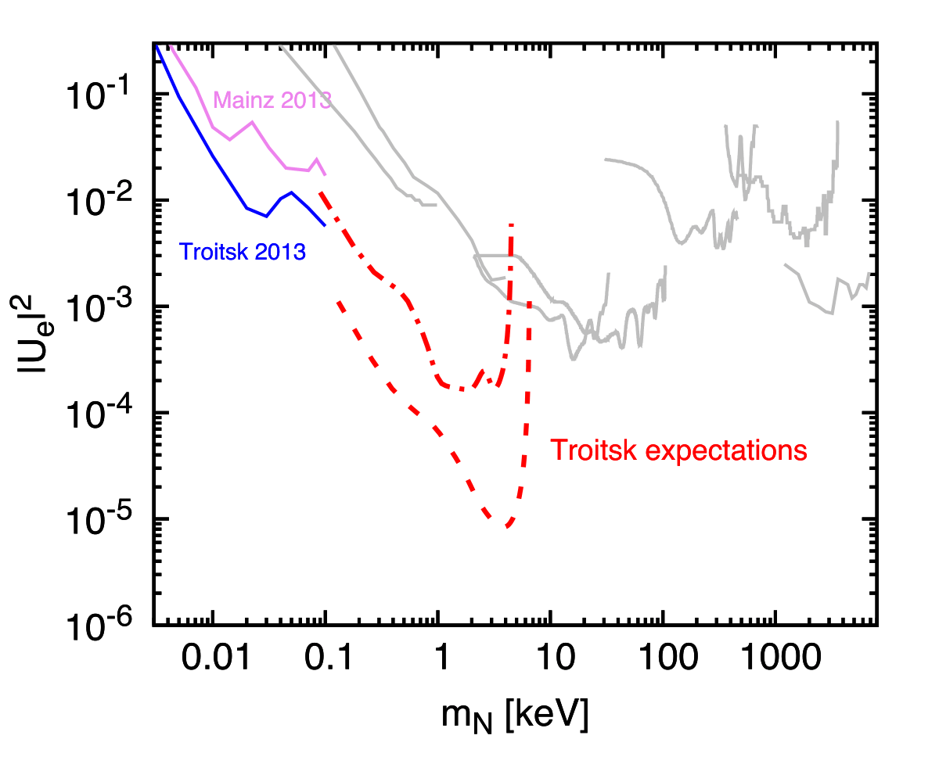
Expected results
Currently possible
Best case scenario

Slide 29

The DataForge
  The DataForge is a scientific framework based on modern trends and solutions in programming.
  It introduces a few new concepts into scientific (hep-physics) software:
    The analysis as a metadata process
    Declarative description of analysis process (the analysis as a build system)
    Convention over configuration on a large scale
  It is completely and “true” cross-platform (not “compile wherever you want on your on risk”).
  It is modular!
  It has a few very important ideological effects that could be expanded further and can open a whole new world of possibilities for scientific data processing.

Slide 30
Compact source
Sterile neutrino measurements do not require “large” source.
Old Troitsk nu-mass source is outdated and is very hard to maintain.
Solution: compact multi-purpose volume for different radioactive sources as well as e-gun measurements.
Problem: manpower.

Slide 31
Graphene infused source
Why make graphene infused radioactive source?
Very high chemical bounding energy (no desorption).
Very uniform surface.
Conductor (no substrate charging).
Mechanical durability (easy to cool down and heat up).
Industrial availability (200$ per sample)

Slide 32
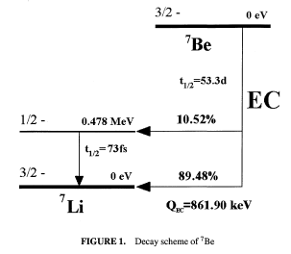
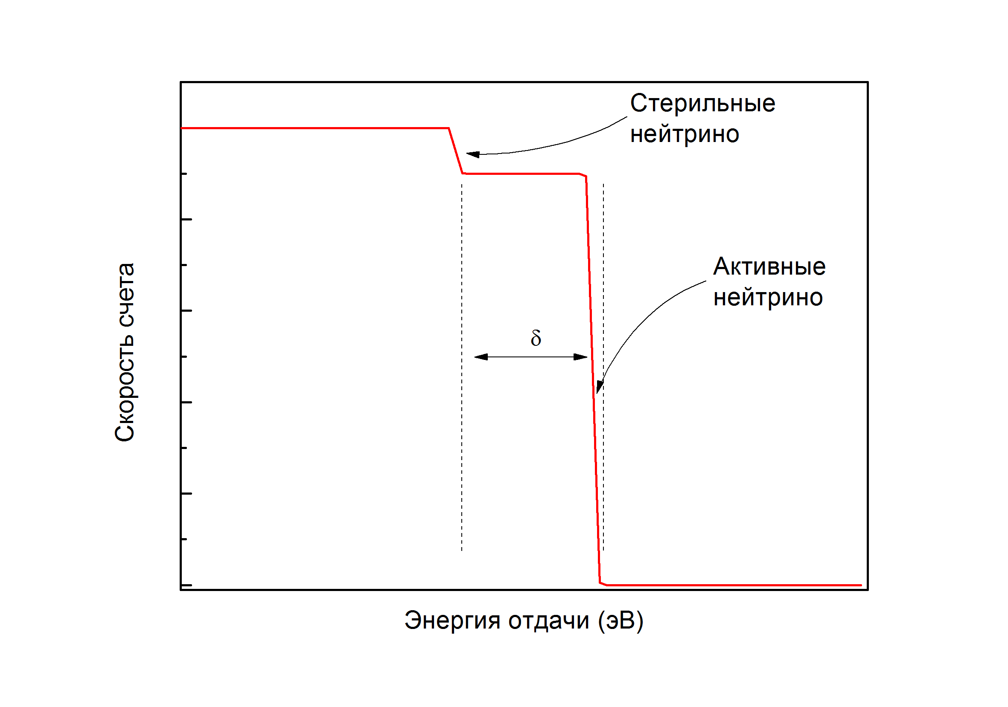
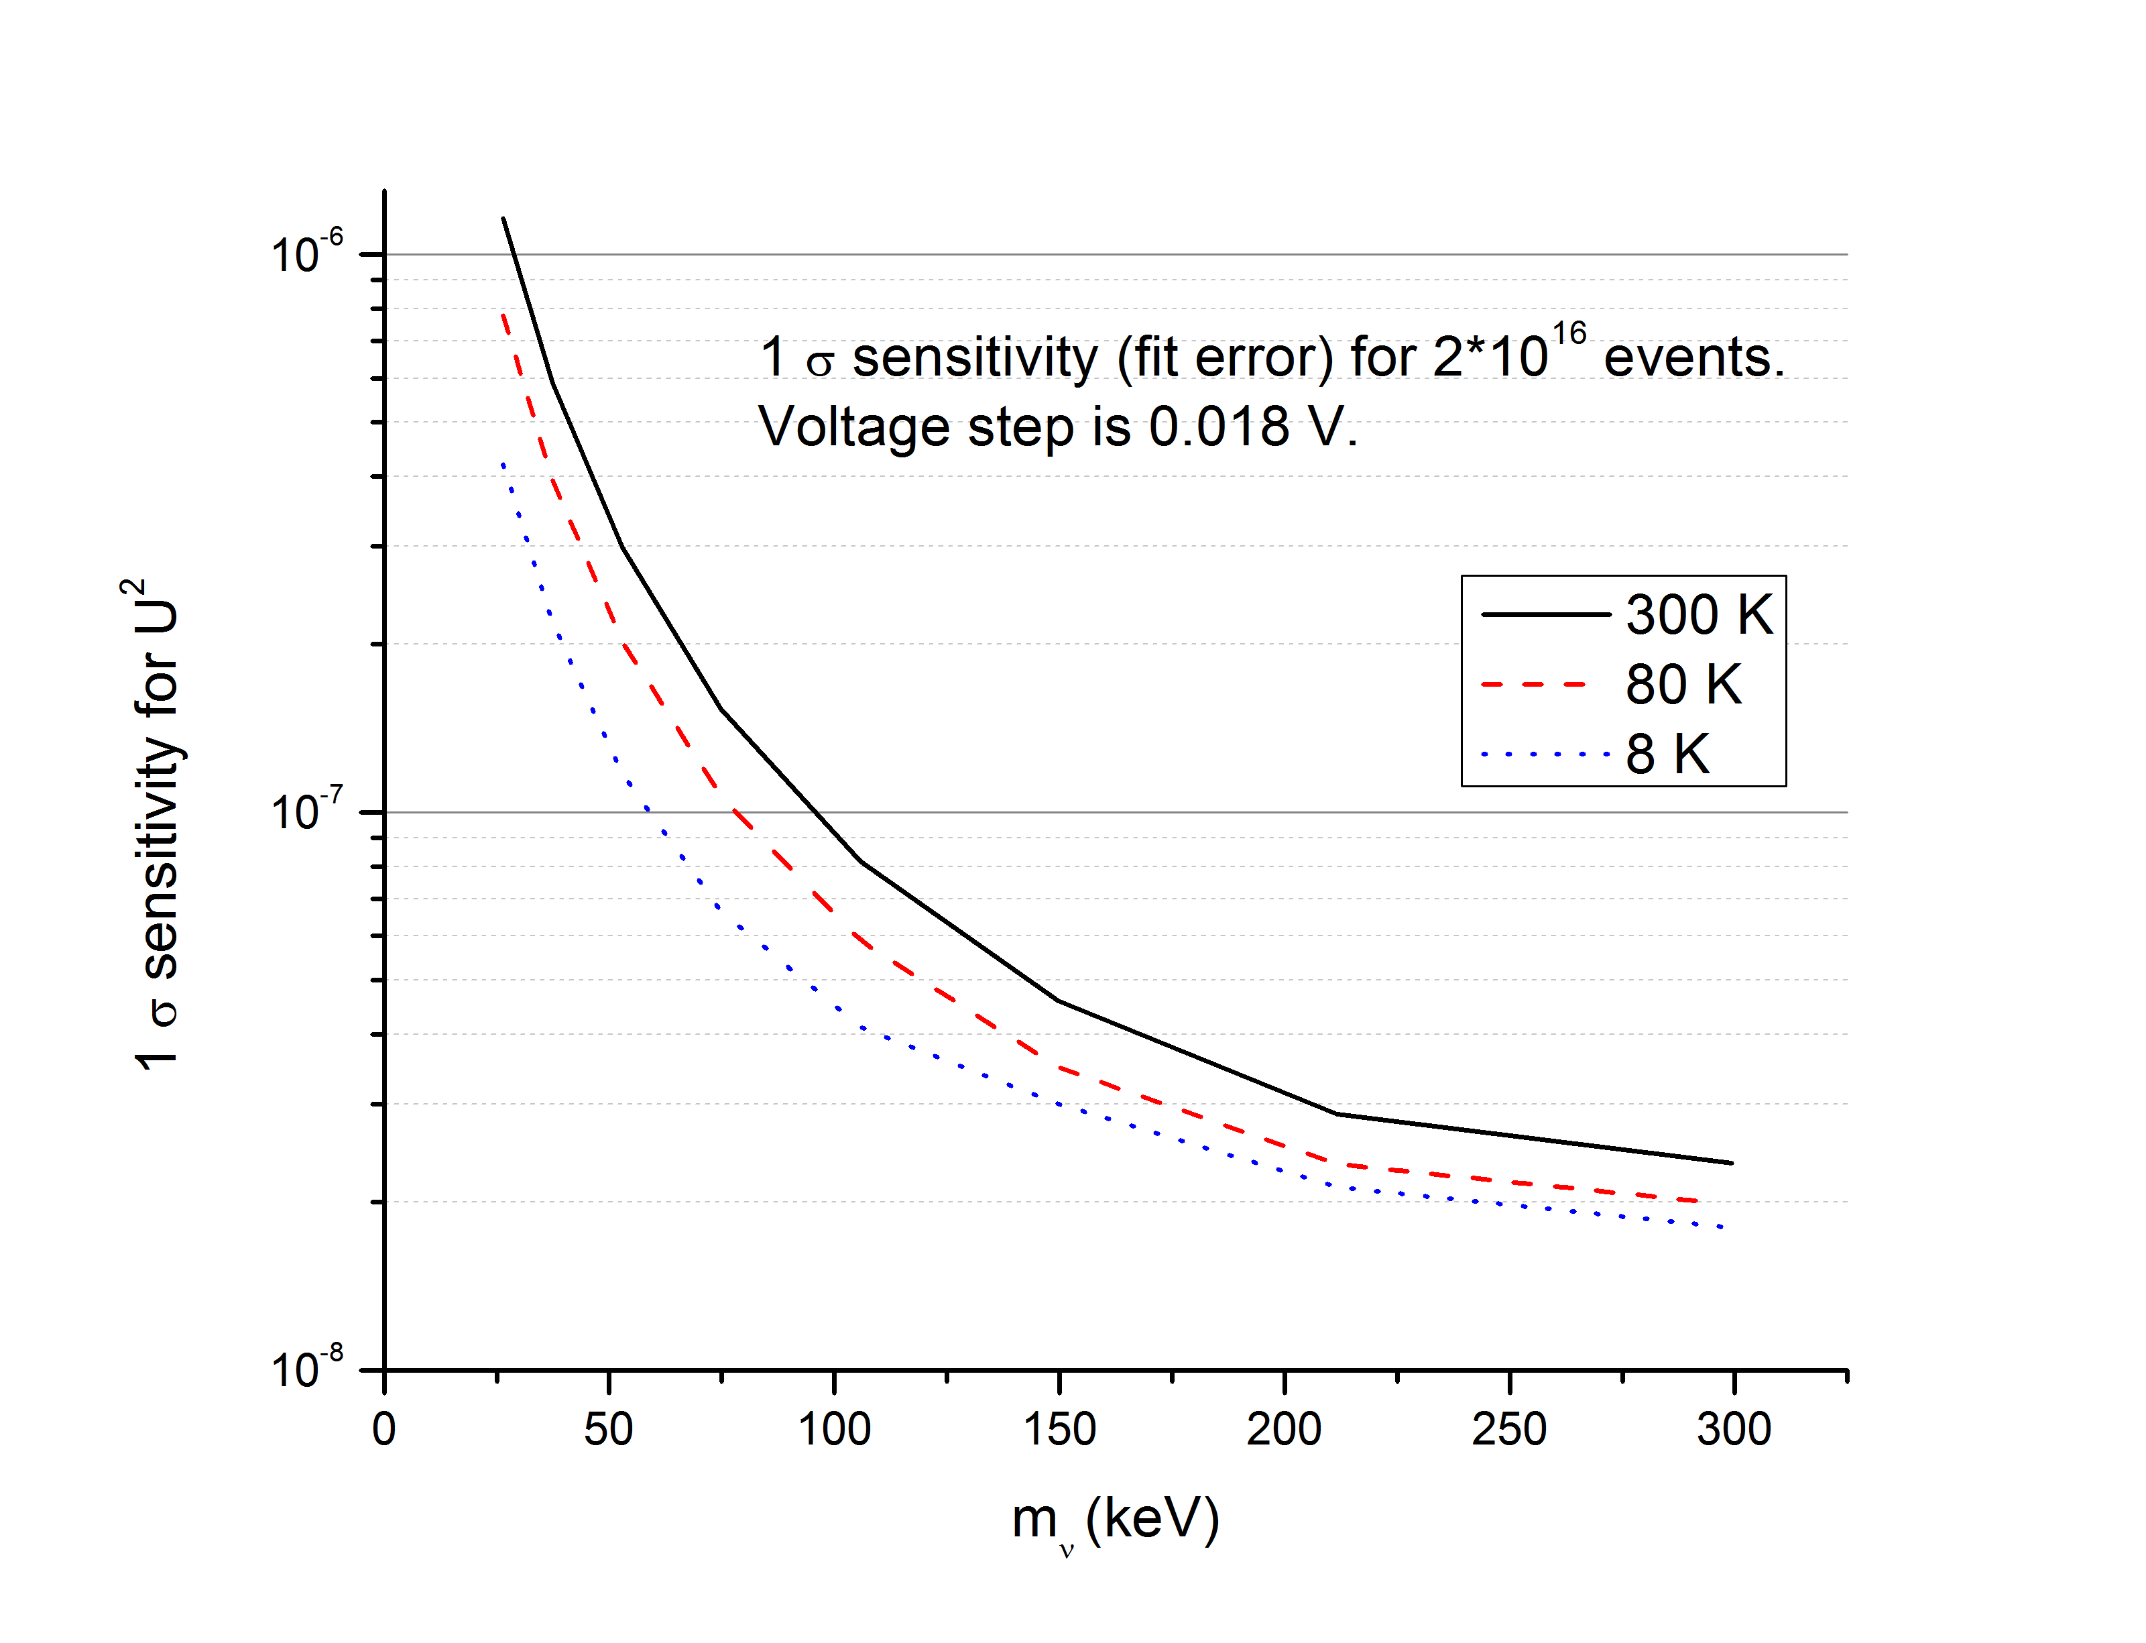

Electron capture instead of beta-decay
$$Be→Li+ν$$

Slide 33
Additional slides

Slide 34
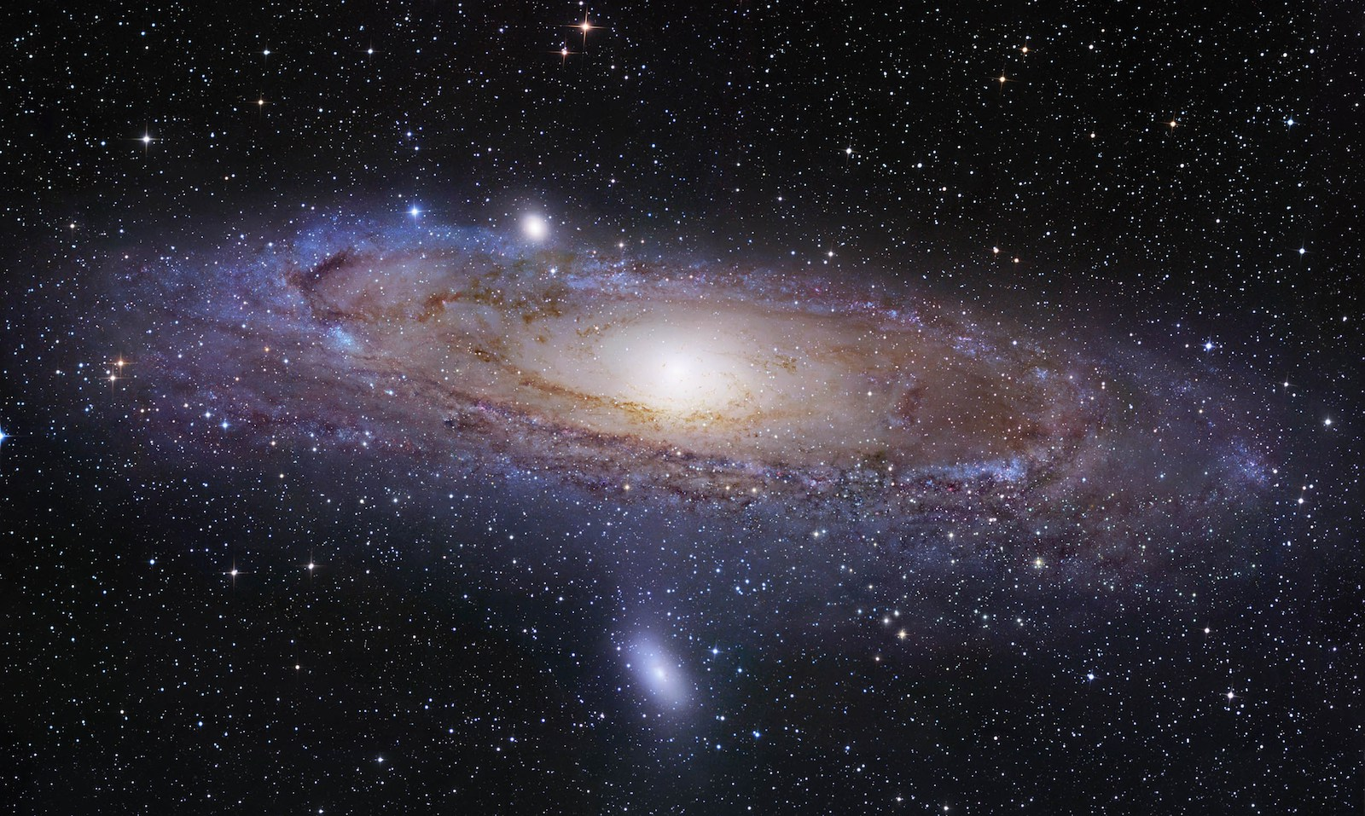
Motivation from cosmology:
Visible matter only 5%. What is the rest ?

Slide 35
Cold or warm Dark Matter?
Heavy particles?
1-10 keV particles?
Simulations favor Warm Dark Matter

Slide 36
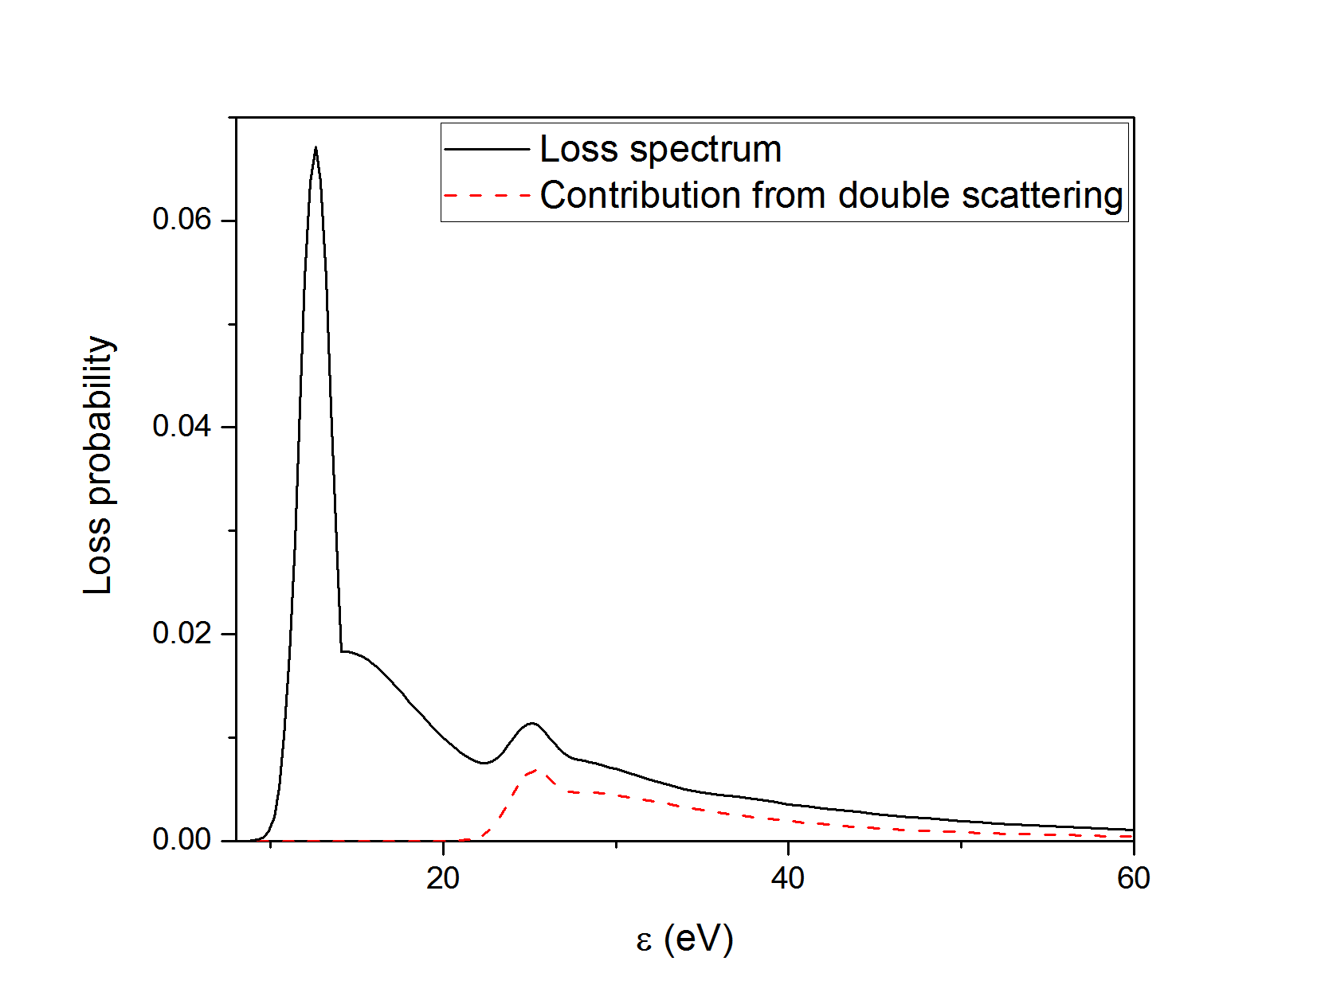

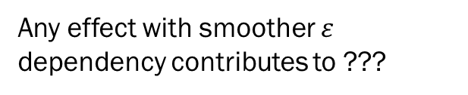
Transmission: loss function
$$ε=E_{in}−E_{out}$$
$X$ depends on $E_{in}$
$$L_{i+1}=L_{i}⊗L_{1}$$
$$L(ε)\overset{→}{ε→∞}\frac{1}{ε^{2}}$$
Any effect with smoother $ε$ dependency contributes to ???

Slide 37
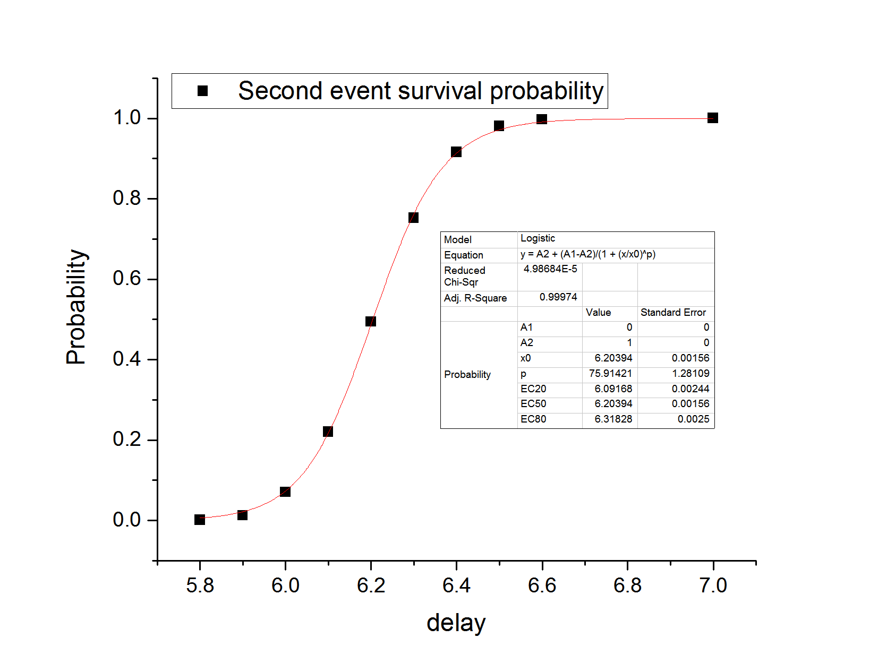
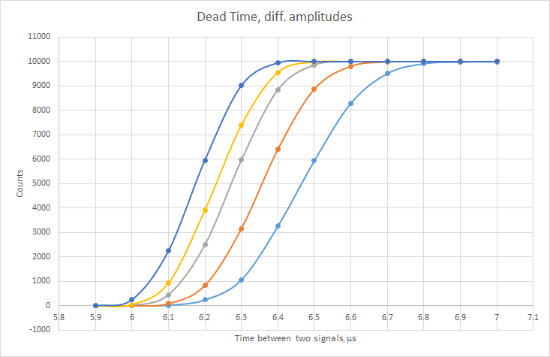
Dead time
Dead time calibration by pulser and two delayed signals

Slide 38
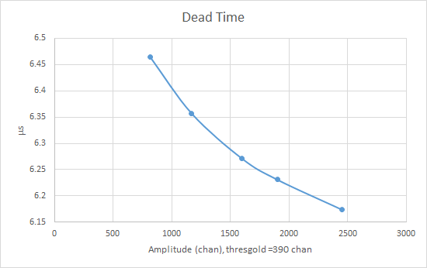
Dead time amplitude dependence

Slide 39
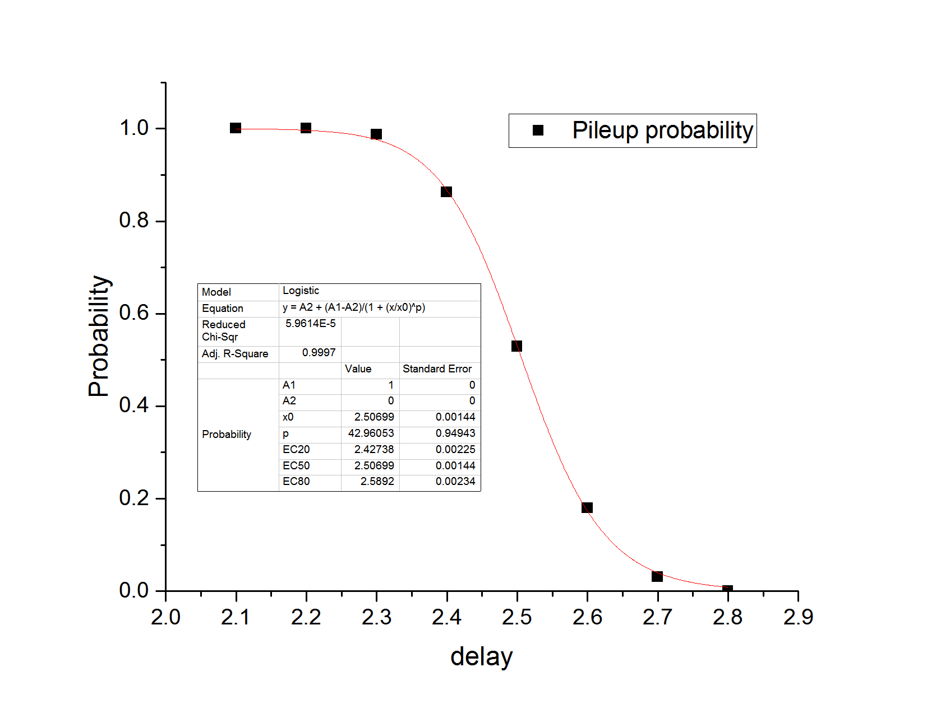
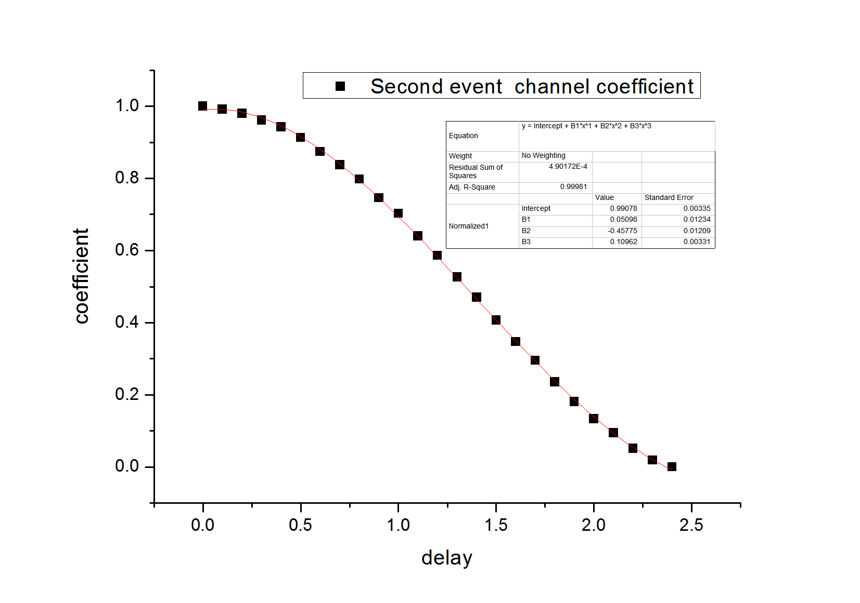
Pileup
Pileup time calibration by pulser and two delayed signals

Slide 40
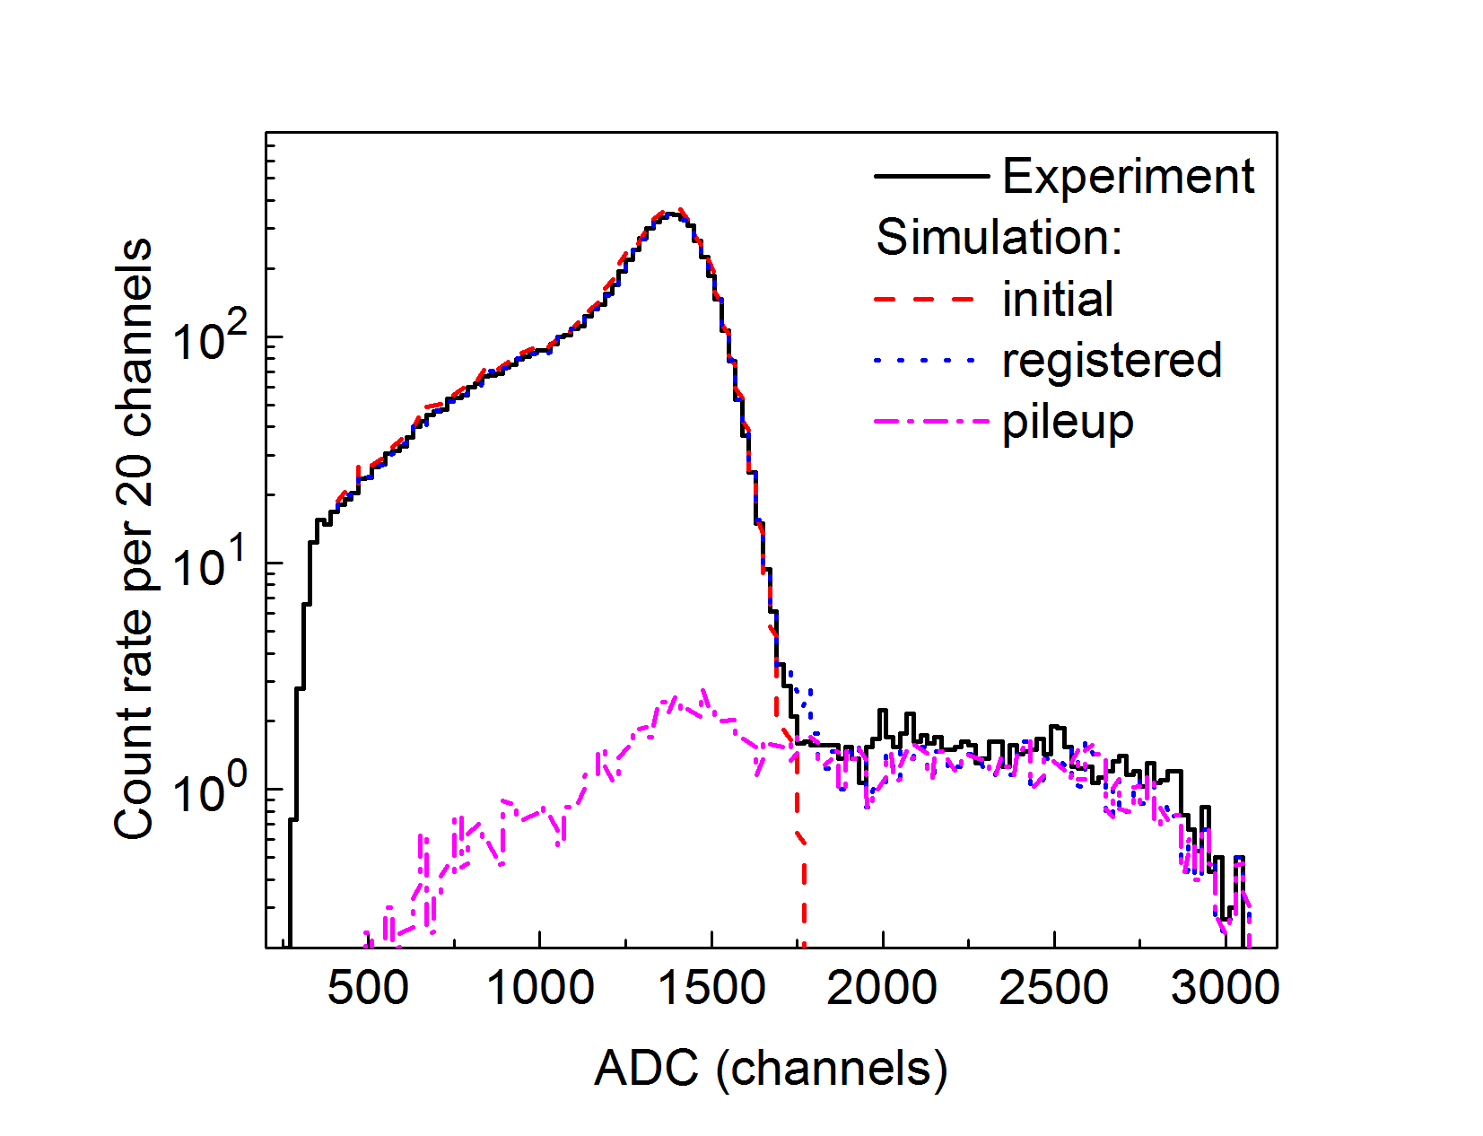
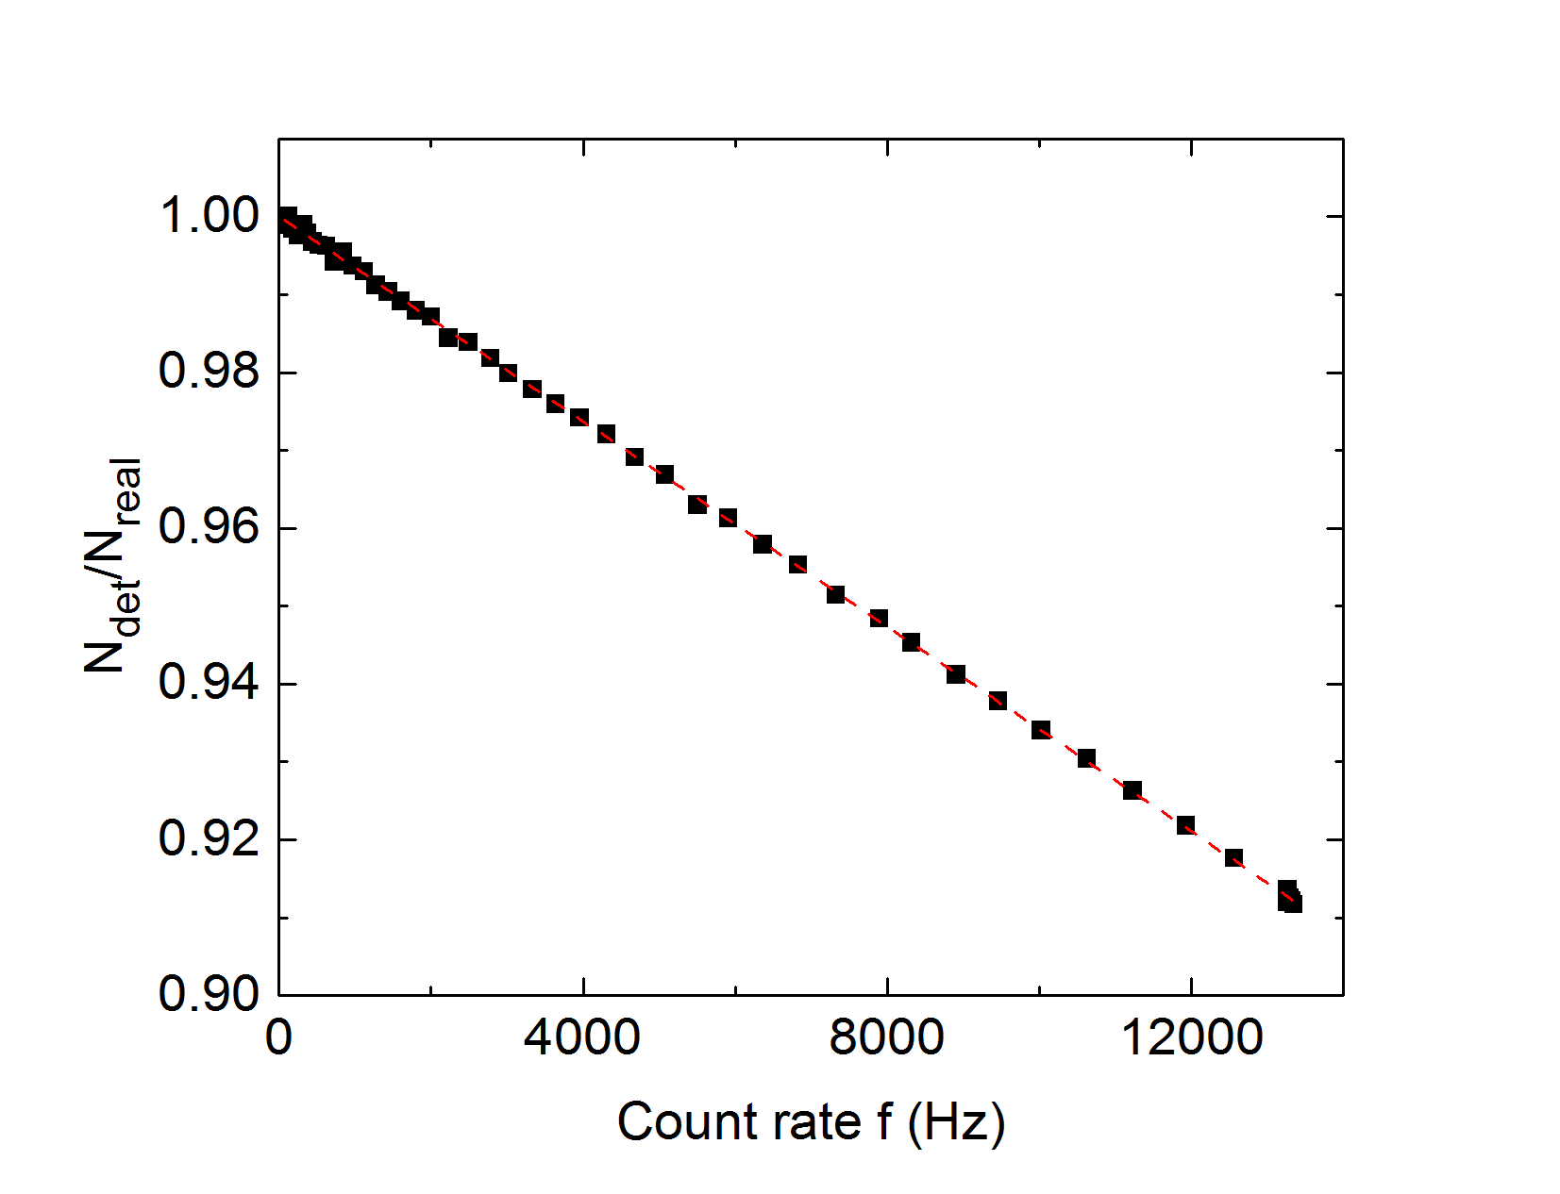
Pileup in real Tritium spectrum
Monte-Carlo simulation using real spectrum and pulser calibration
Life time versus measured count rate

Slide 41
Adiabaticity violation
Simulation: Adiabaticity is not violated above 13.5 kV

Slide 42
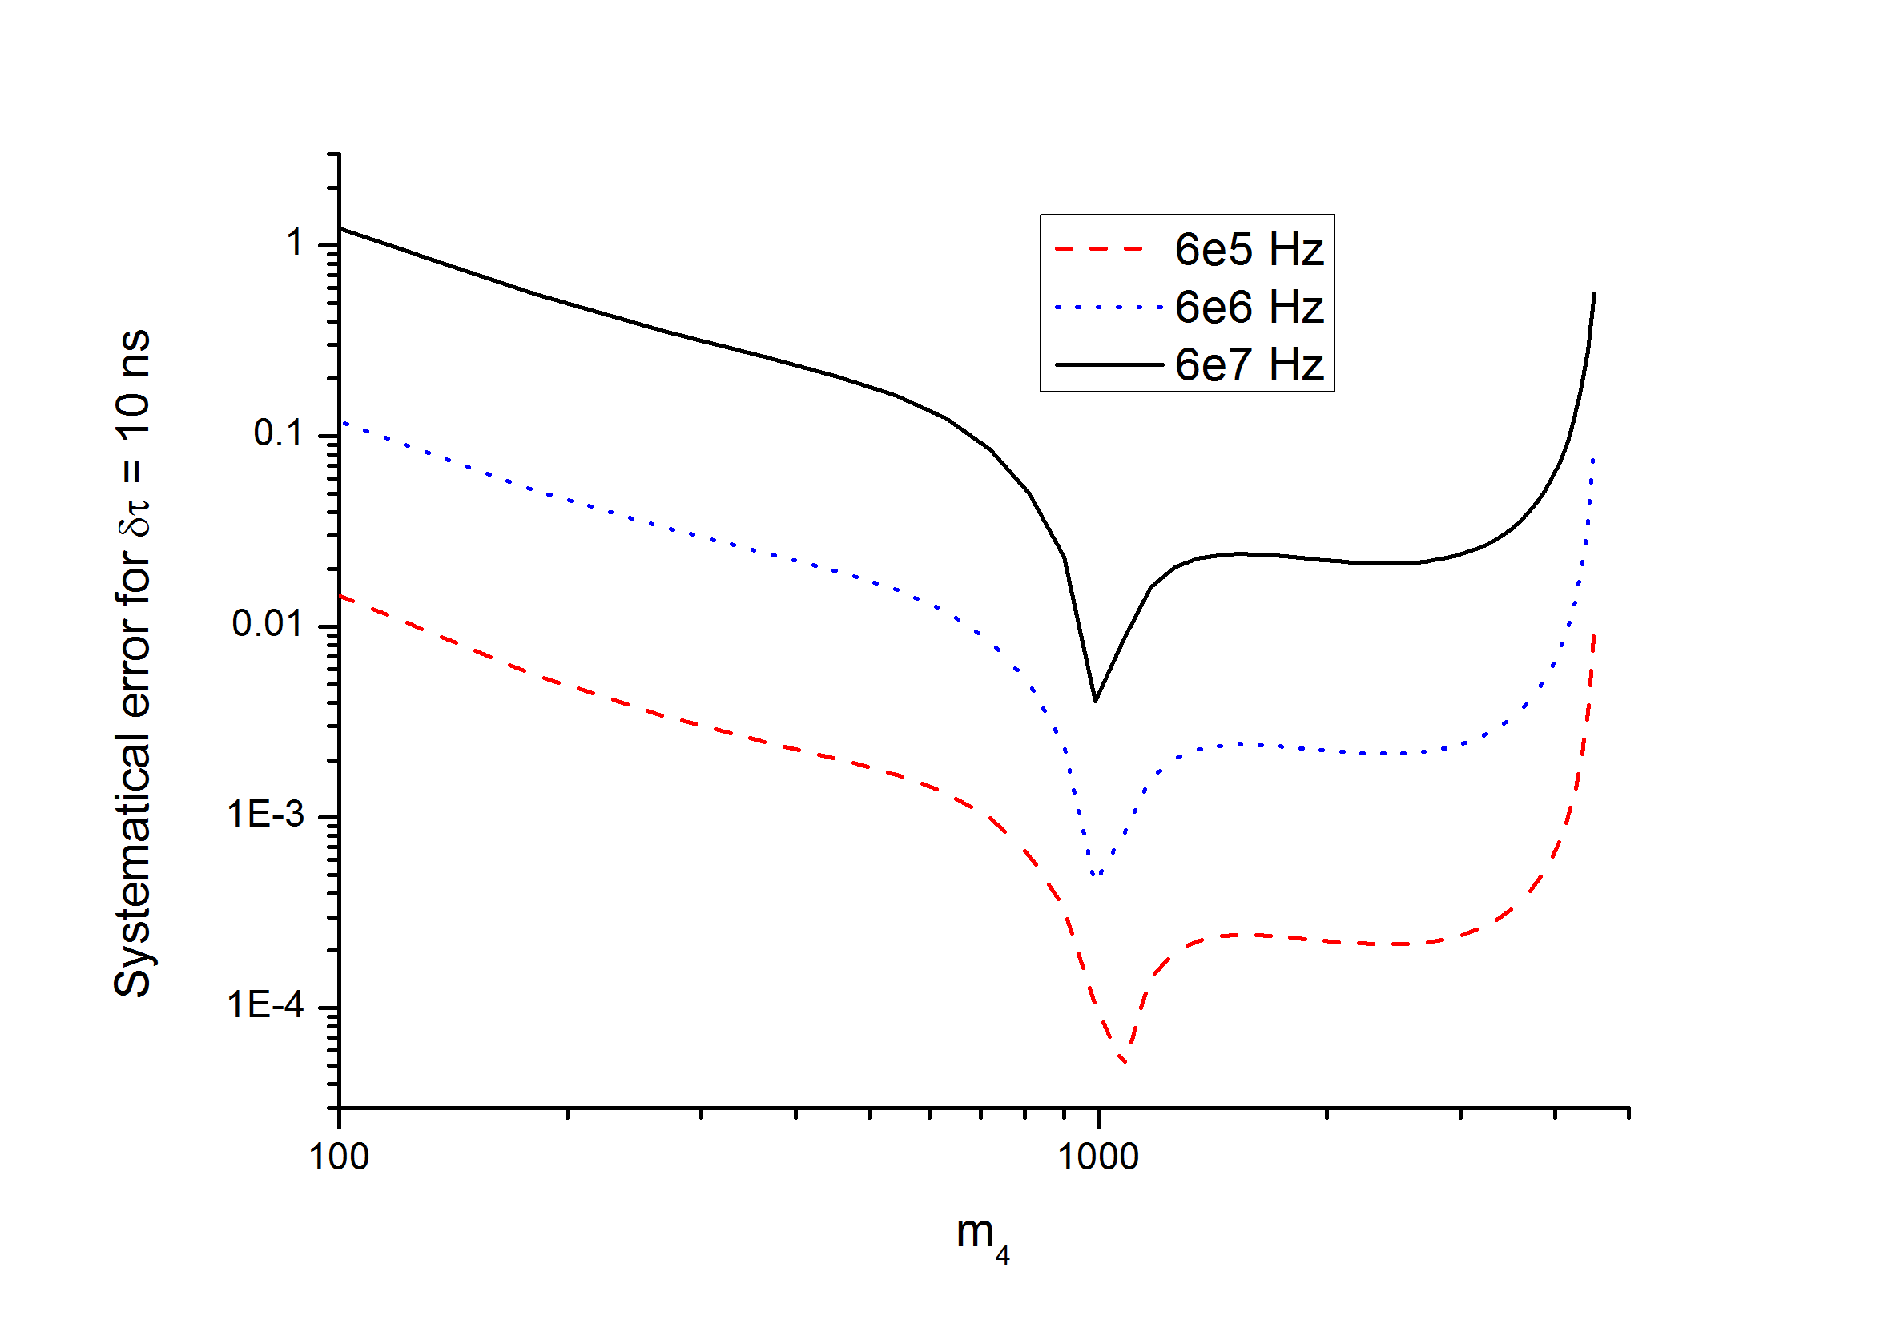

Systematics: dead time
The correction factor:
$$N=N_{0}\left(1−N_{0}\frac{τ}{T}\right)$$
The dead time uncertainty is the main current limit on experiment sensitivity.
P.S. We wish to switch to completely new readout with continues signal digitization in upcoming run in May 2017

Slide 43
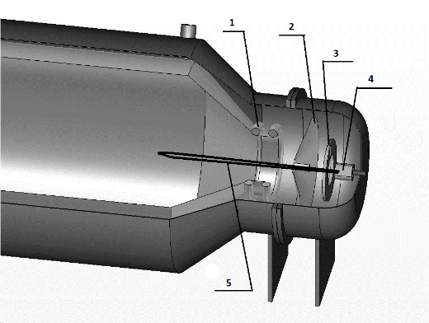
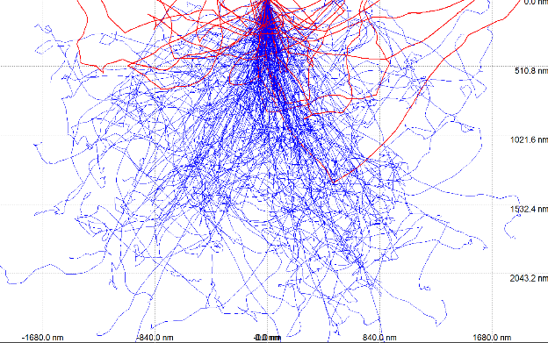
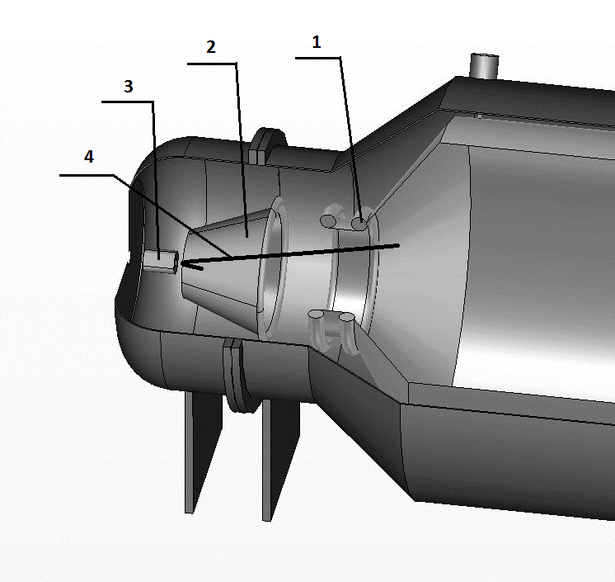
Detector backscattering
Electrostatic mirror
Up to 20% electrons scatter back from Si-detector.
CASINO simulation
Magnetictic mirror
NIM A832 (2016) 15
arXiv:1511.06129

Slide 44
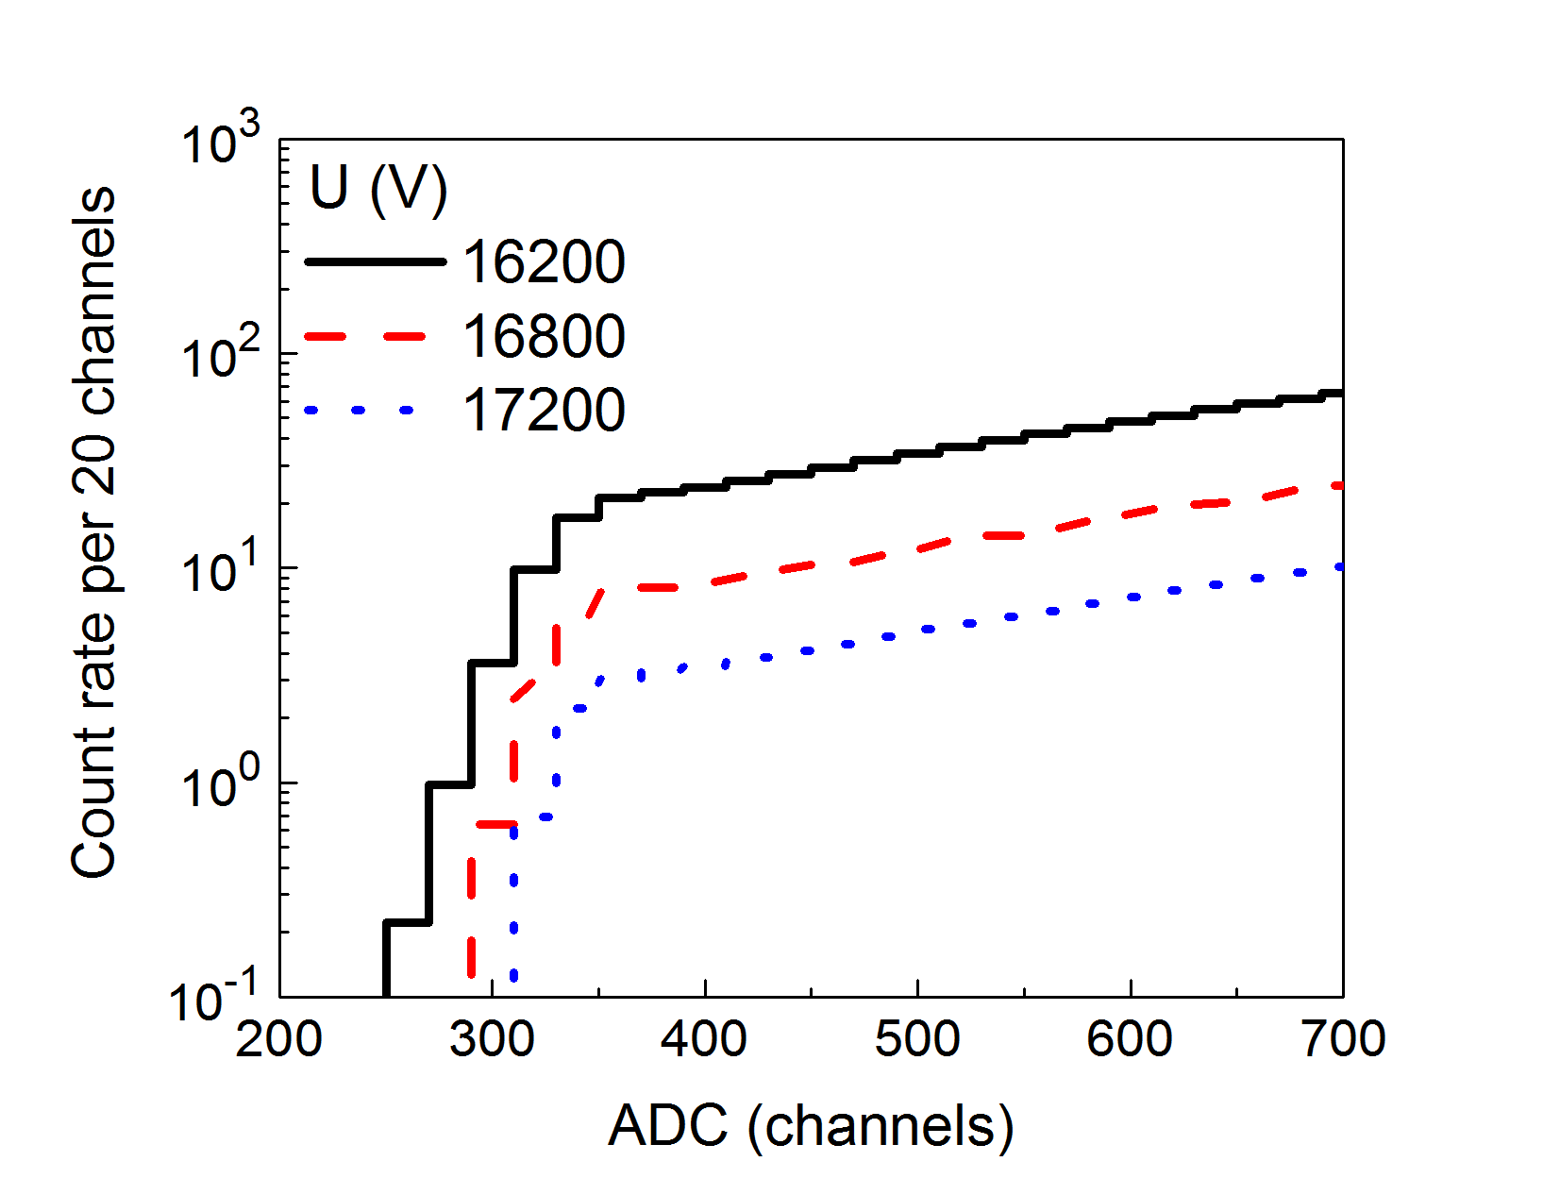
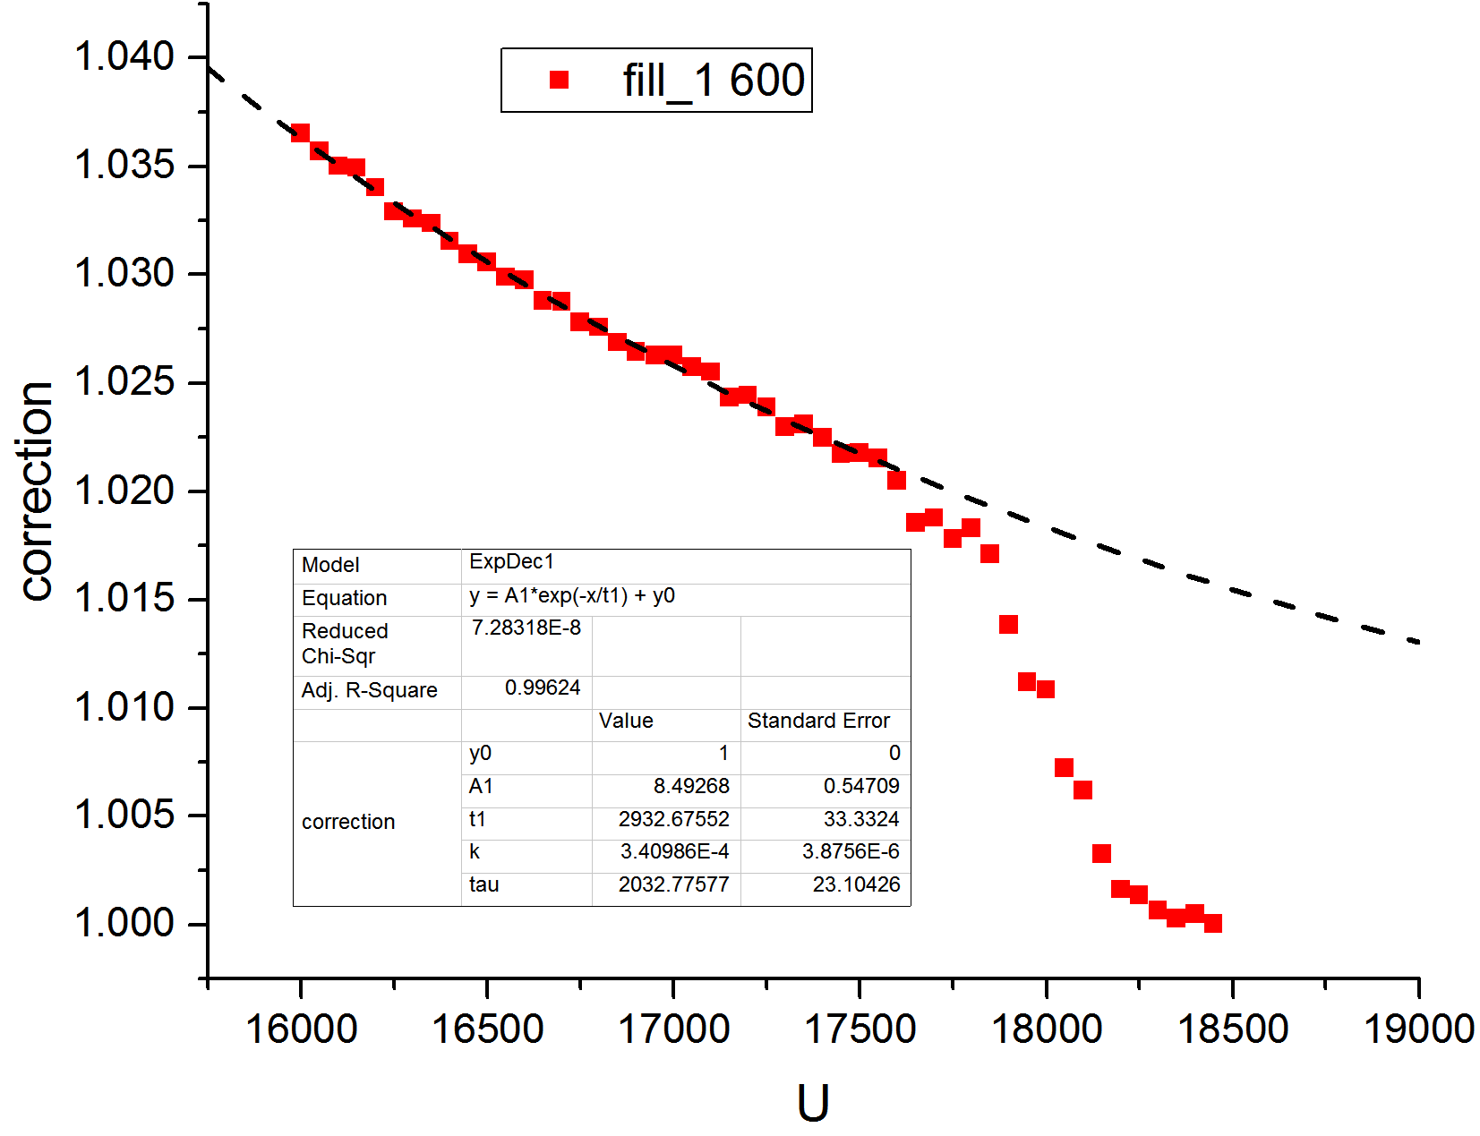


Detector threshold
Spectrum shape near cutoff point
The estimated correction factor vs. U_sp
$$D =A∗e^{\frac{c}{σ}}$$
$$corr=1+A1∗e^{−\frac{U}{t1}}$$

Slide 45
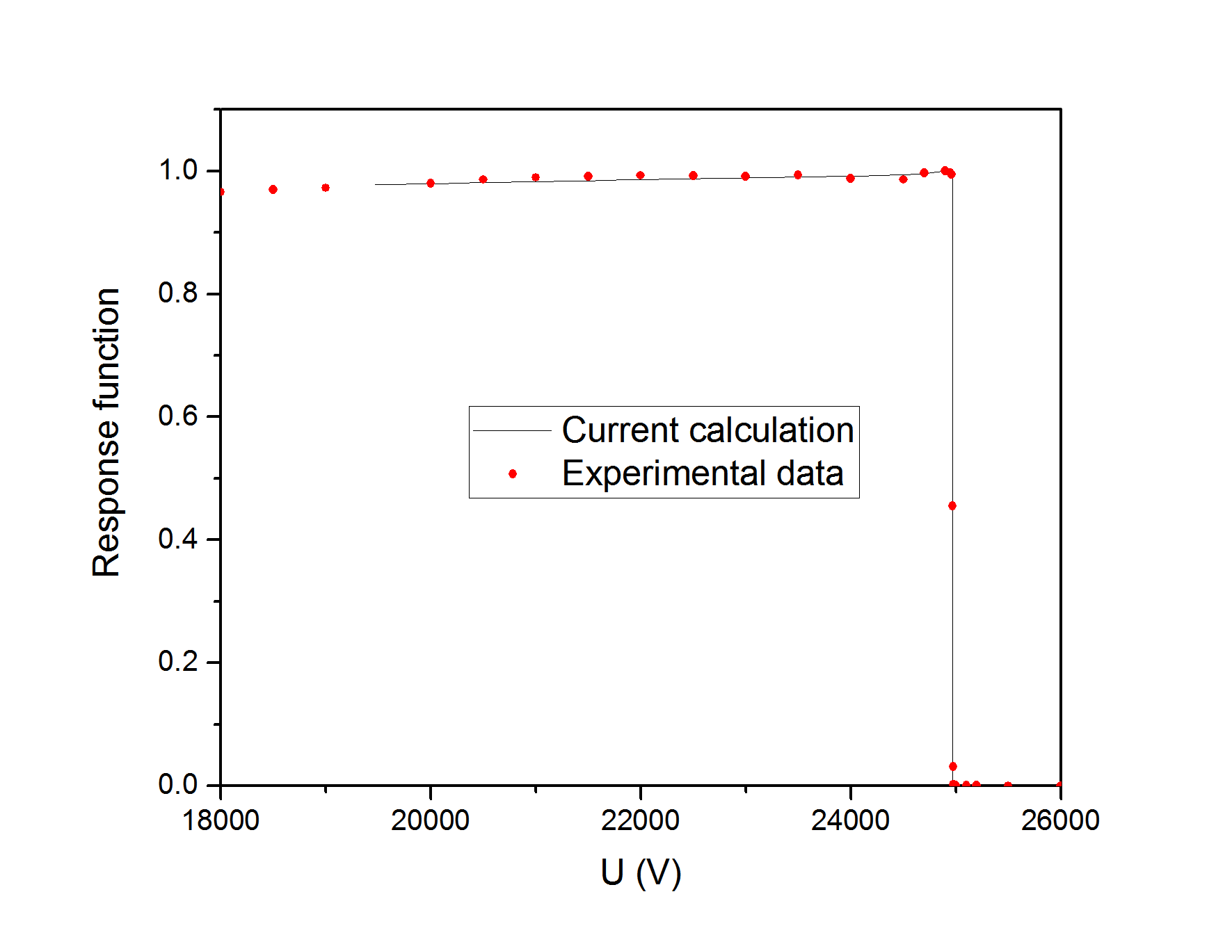
Detector backscattering: experimental
Count rate for 25 keV electrons vs spectrometer retarding potential

